Slide 1

Interactive
Medium-Fi
Prototype
Notes:
Intro
Project title: Designing for an active lifestyle

Slide 2

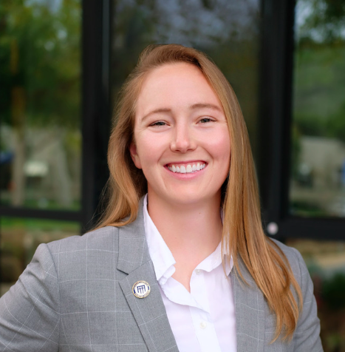

Our team:
Fahad
Nabi
Lyndsea Warkenthien
Elysia
Smyers
Notes:
Intro
Team Members

Slide 3
Roadmap
01
06
02
07
03
08
04
09
05
Value Proposition
Revised Interface
Sketches
Problem/Solution Space Overview
Medium-Fi Task Flows
Design Values and Tensions
Prototype Implementation
Key Tasks
Appendix
Usability Goals and Key Measurements

Slide 4
01
Value Proposition

Slide 5
Our platform is a community-focused platform designed for individuals undergoing lifestyle transitions. We prioritize physical and mental wellness by encouraging group-goal accomplishments, uniting people in their shared journey towards better well-being.
About:
Our Mission Statement: A collective pursuit of well-being.
Name Origin: Derived from the Greek word, Enosis, which refers to the movement of communities that formed the modern political and social union of Greece
Notes:
Intro
Project title and team
Value Proposition
Problem/solution overview

Slide 6
Key User Benefit:
Leverage the power of community to motivate, inspire, and drive progress. No one goes through a lifestyle or wellbeing change alone.

Slide 7
02
Problem and Solution Space Overview

Slide 8
Problem Space:
Solution Space:
Lifestyle transitions can often be lonely, causing feelings of isolation, discouragement, and a sense of being overwhelmed
By setting shared goals, members can motivate and push each other forward, creating a snowball effect of positivity and progress

Slide 9
03
Design Values

Slide 10
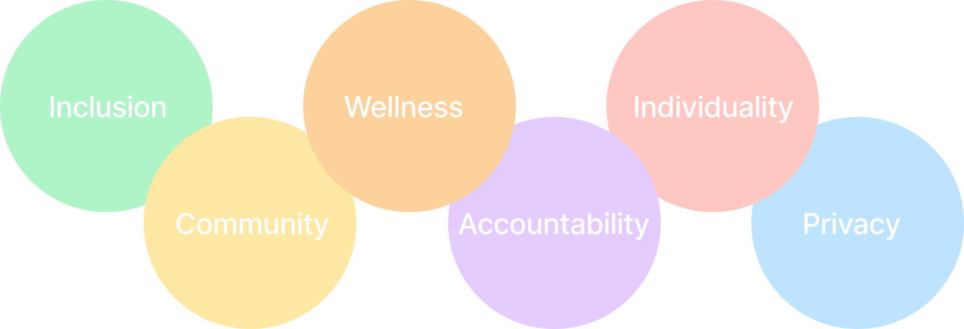
Design Values

Slide 11
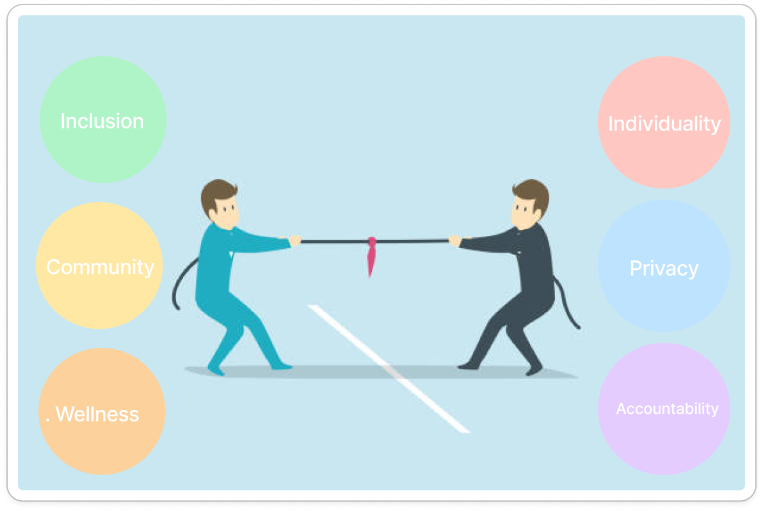
Balancing Tensions
Finding the right balance between design values will require extreme user testing, ongoing user feedback, and evaluating tradeoffs with our MVP.
Inclusivity vs. Individuality: While building an inclusive community, specific individual preferences may not be represented → 1 on 1 Biweekly Coffee Match/Pairings
Community vs. Privacy: Building community requires one to put themselves out there, and share individual life experiences which may be private → Group Leaders and Establishing Platform and Community Norms
Wellness vs. Accountability: Strict accountability may have adverse effects on one’s own wellness if they aren’t aware of their limitations → Weekly Wellness Check-In

Slide 12
04
Key Tasks

Slide 13



SIMPLE Log A Physical Activity
TASK
MODERATE Search For/Add A Friend
TASK
COMPLEX Create A Group TASK
I
II
III

Slide 14
05
Usability Goals and Key Measurements

Slide 15
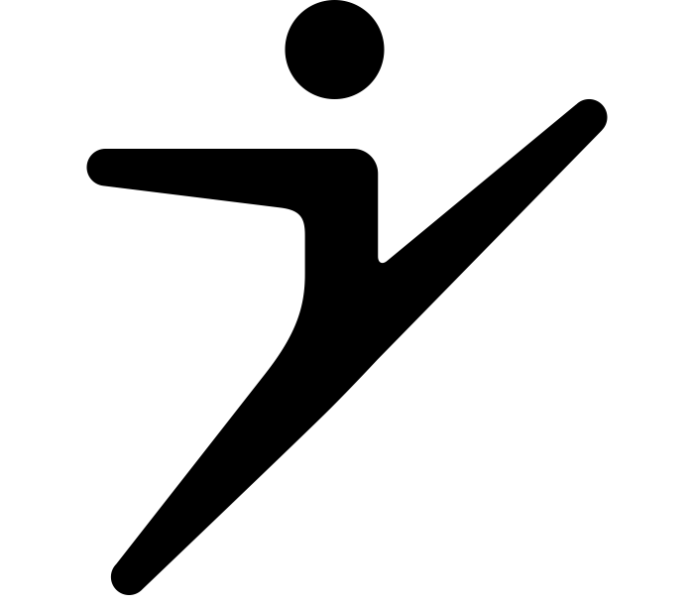
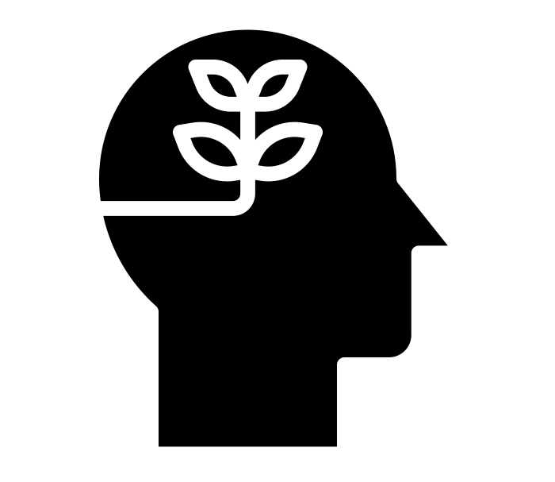
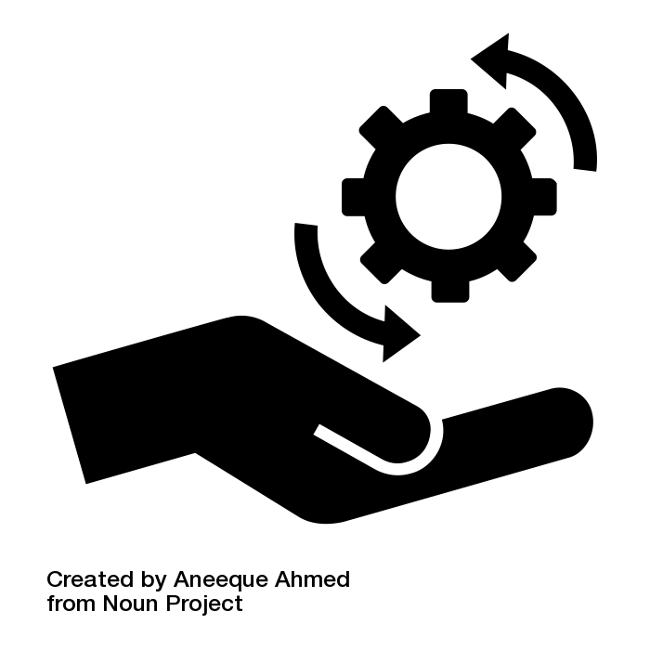
Usability Goals:
Learnability:
Does the user log activities faster the second time?
Efficiency:
Would completing this task be easy and not a waste of effort?
Fun:
Does the user have fun signing the guest book of a goal?

Slide 16
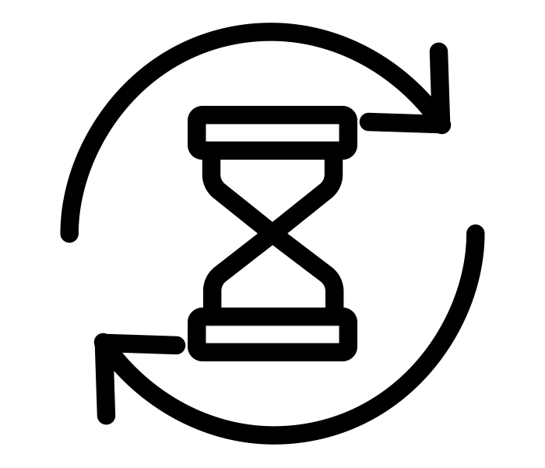
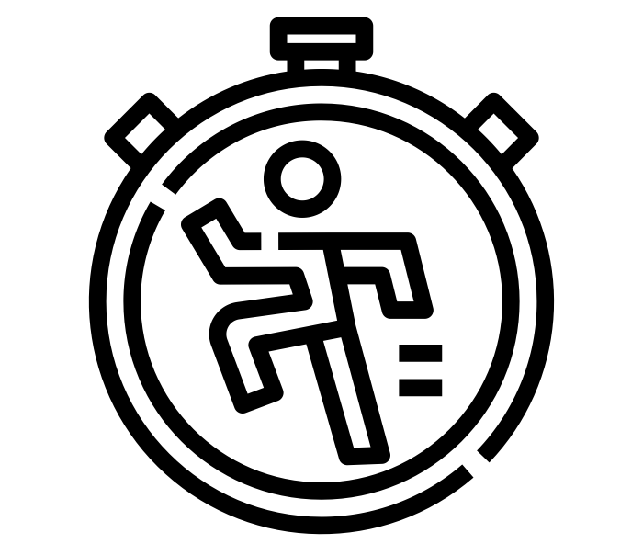

Key Metrics
Fun Key Metric
(Scale of 1-5):
Does the participant have fun signing the guest book?
Learnability Key Metric (Minutes/Seconds):
Task Completion Time?
Efficiency Key Metric (Scale 1-5):
How easy is the task to complete?

Slide 17
Aligning Product Development
With Usability Goals/Metrics
Fun
Learnability
Efficiency
Reveal the Log Book Only To Users Whose Activity Completes Shared Group Goal
Provide Visual Components of Key Activities And Simplify Logging UX:
“I did [X] for [Y]”
Streamlining UX Workflow When Adding Members and Creating Shared Groups

Slide 18
06
Revised Interface
Changes

Slide 19
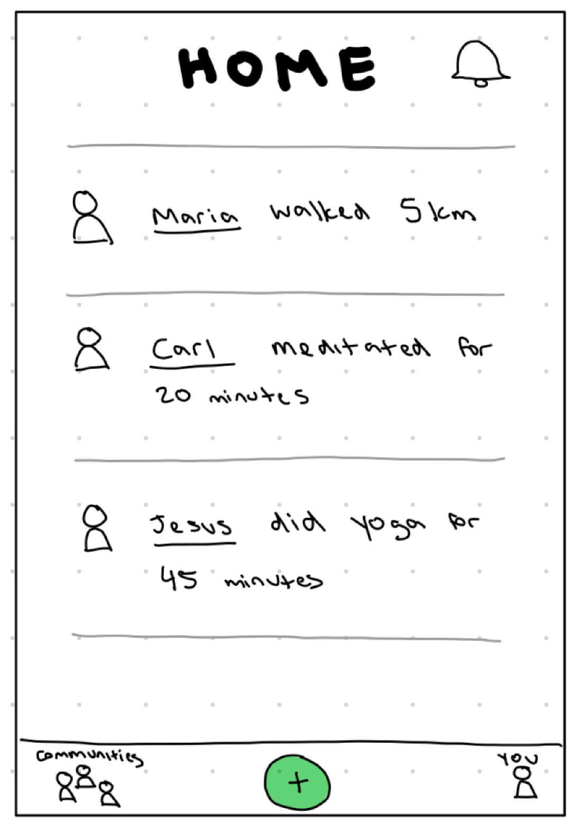
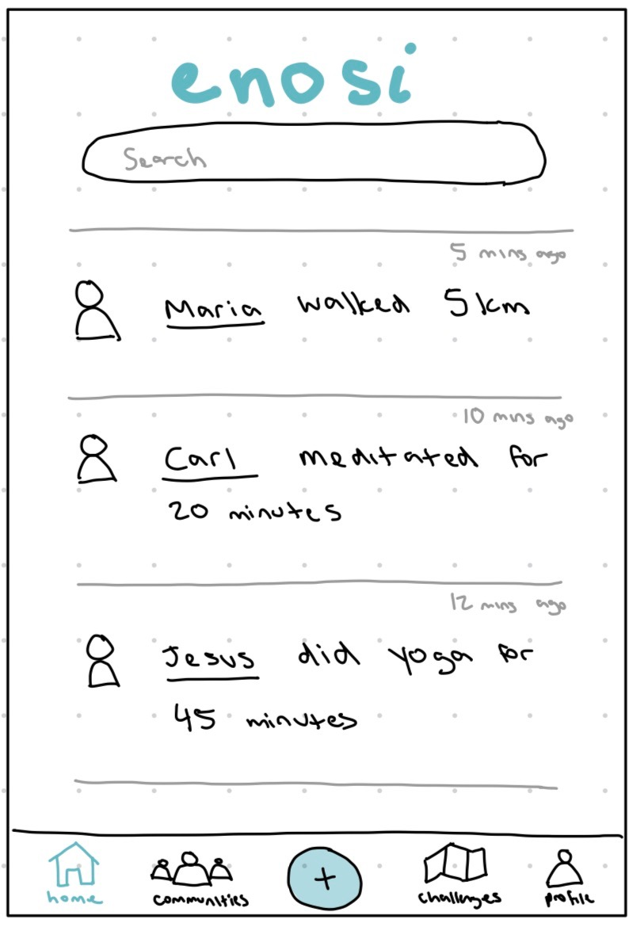
Major Design Change #1: Navigation Bar
Differences In Which Page Feels Most Like “Home”
Central Home Base Reinforced by Our Branding
Logo Highlights to Indicate Page Location
Unintuitive Buttons Which Navigate To “Hidden” Pages
Uniform Navigation Bar with App Pages (Ecosystem Feel)
Confusion Over Page Location And Where Users Are
Disjoint and Fragmented User Navigation Experience
Uniform, Intuitive Navigation Path in App Ecosystem
What We Learned
How We Revised

Slide 20
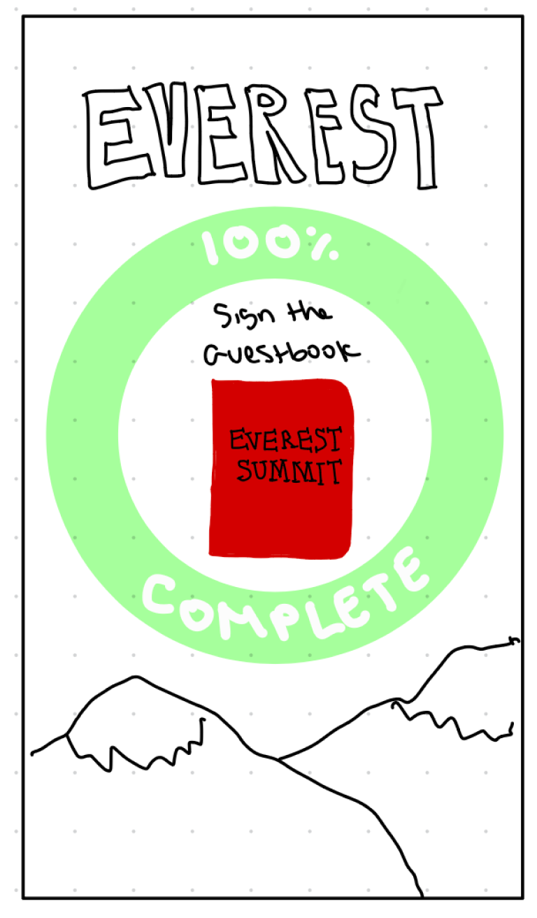
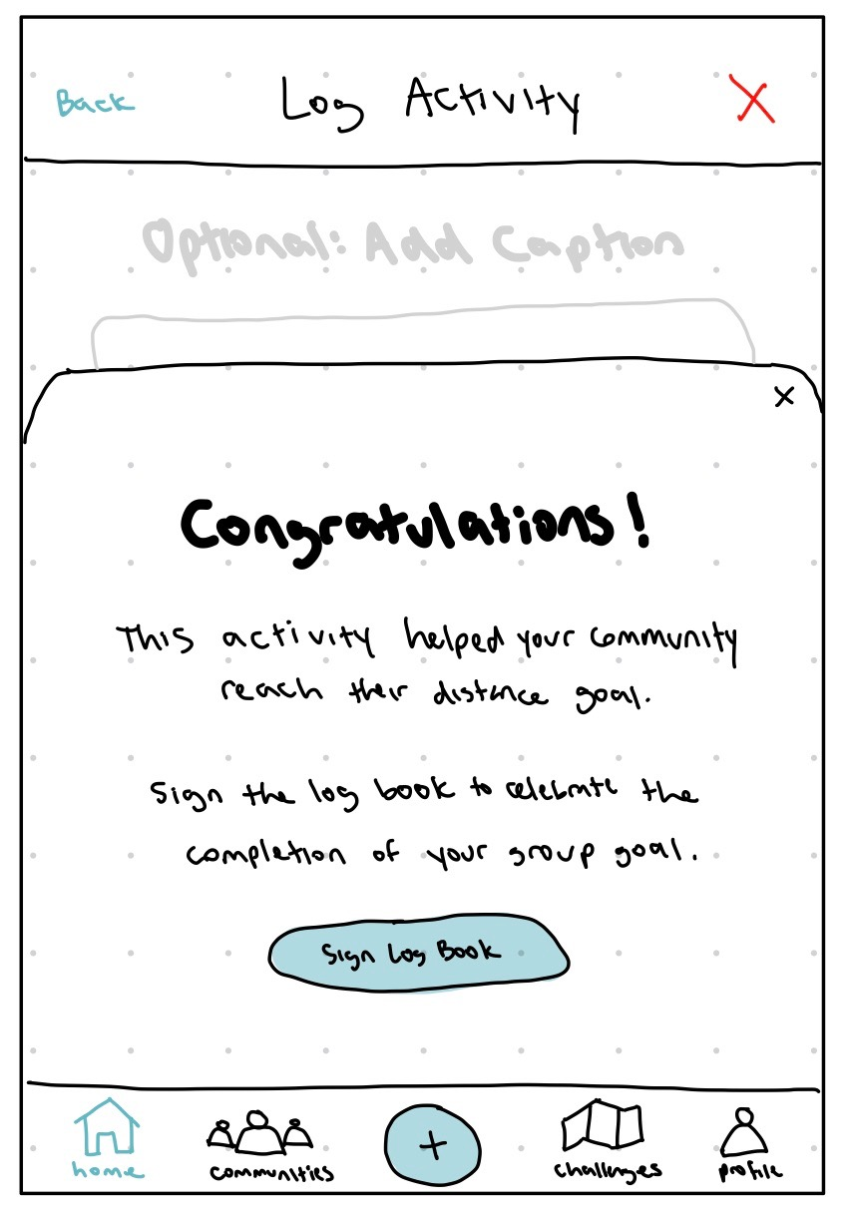
Major Design Change #2: Log Book Access
Cluttered UI with Inconsistent Graphical Elements
Ability to Log Activity, Without Signing The Log Book
Lack of User Control: No Way To Skip Log Book
User Education of Log Book Functionality
Confusion Over Purpose and Functionality of Log Book
Clear Button To Sign Log Book
No Clear Button Interaction
Intuitive Log Book Experience and Clear User Engagement Path
Poor User Experience of Log Book Feature
What We Learned
How We Revised

Slide 21
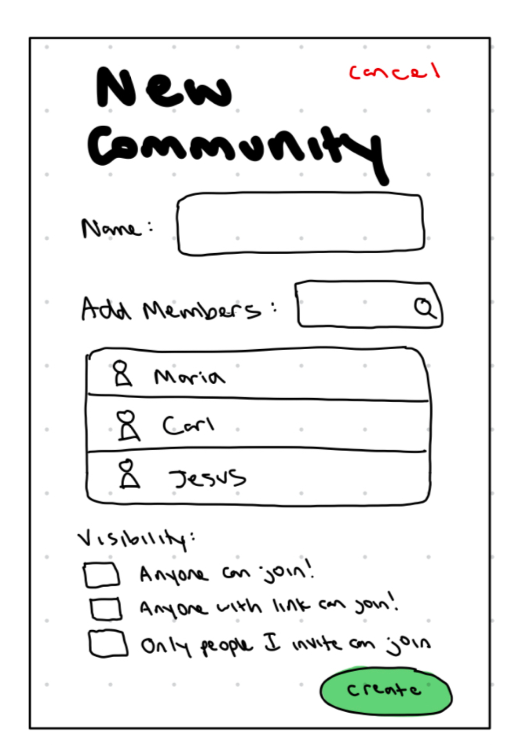
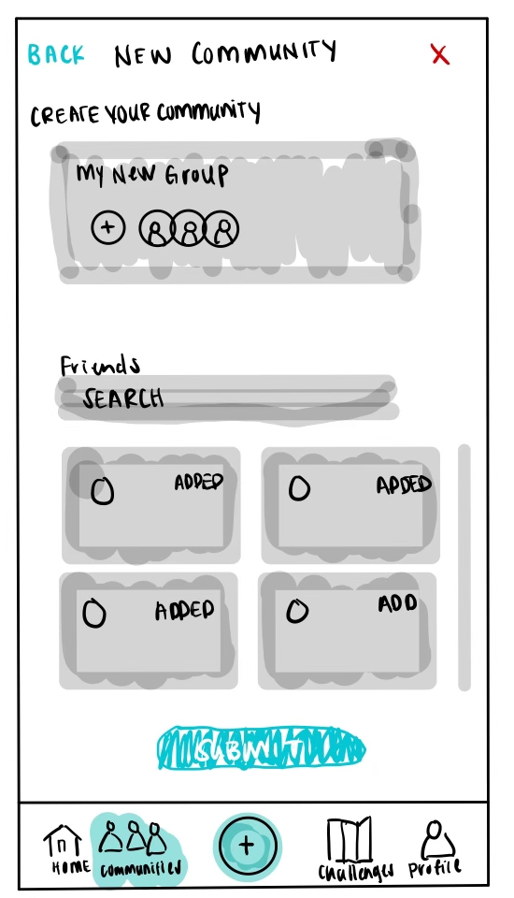
Major Design Change #3: Group Creation
No Clear Interaction Button that Adds Members
Clear Understanding of Member/ Group Status
(Added or Not)
Many Users Were Not Fans of the “List View” Directory
Interactive Display of Friend Profiles that Match Search Queries
No Visual Way to See Who Is Currently Added (Group Status)
Scroll Bar To Maximize Search Visibility of Profiles
Frustrating UX of Viewing & Adding Multiple Members Concurrently
User-Friendly Experience of Adding Multiple Members To
A Group
What We Learned
How We Revised

Slide 22
07
Medium-Fi Task
Flows

Slide 23
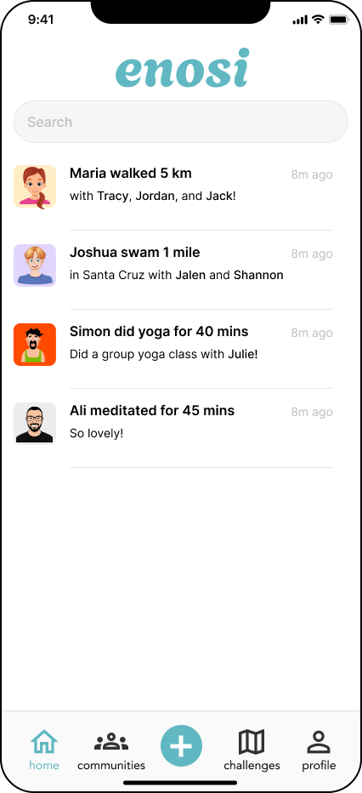
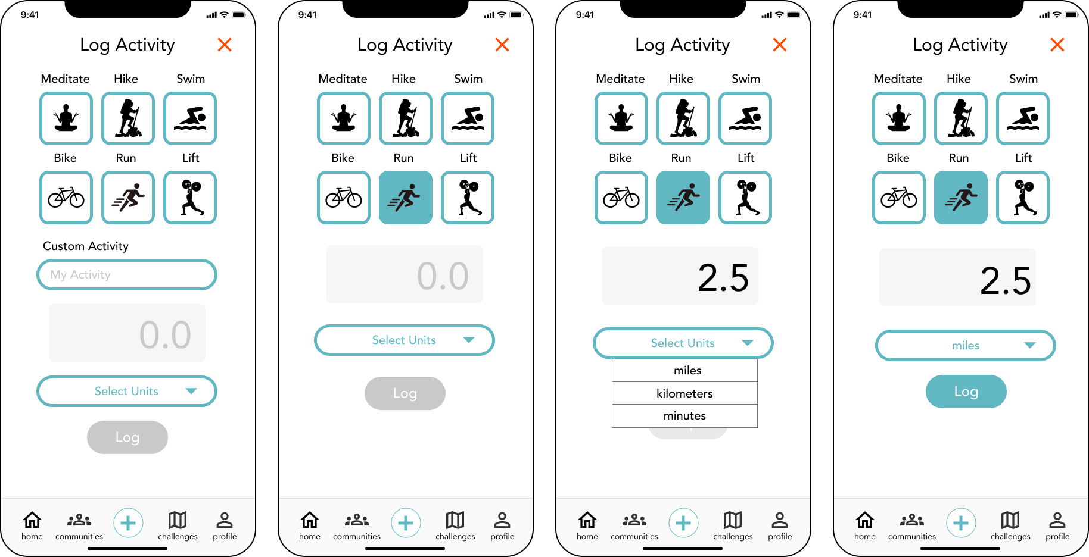
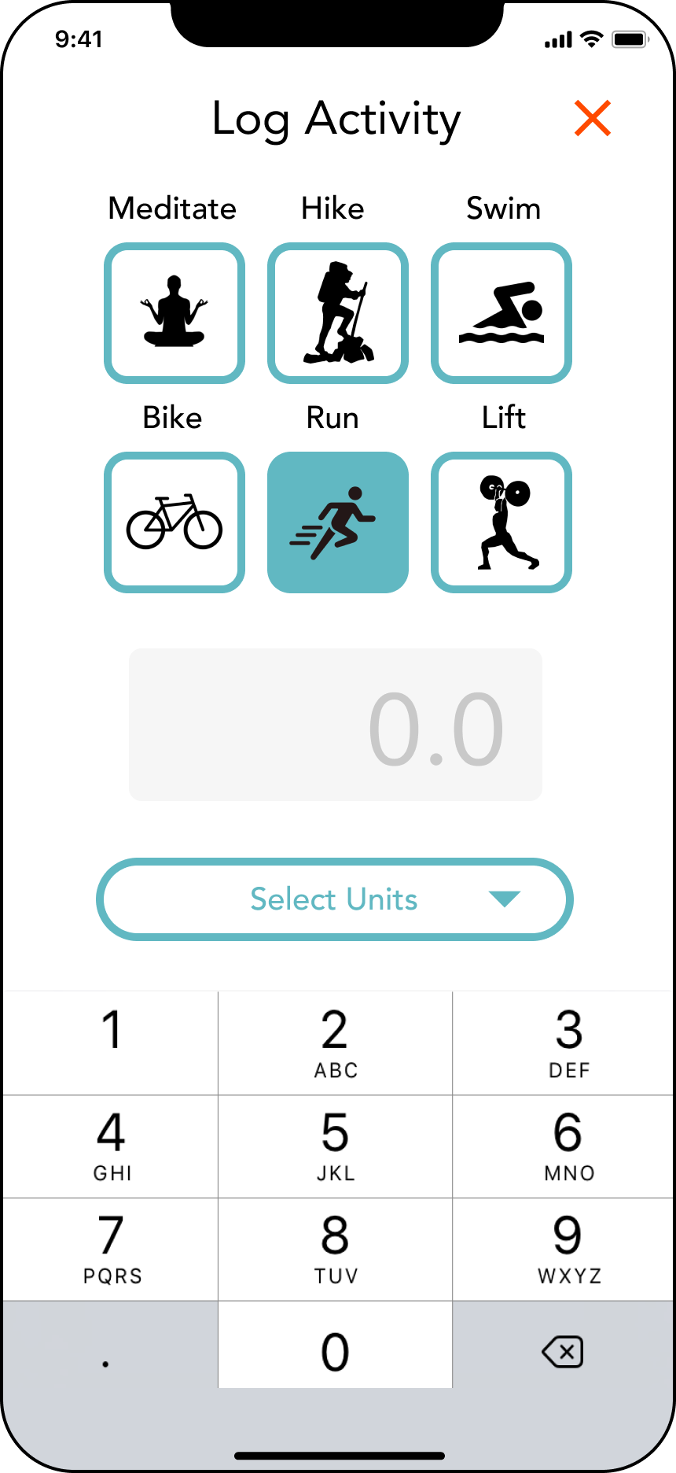
Task 1: Log a Physical Activity

Slide 24
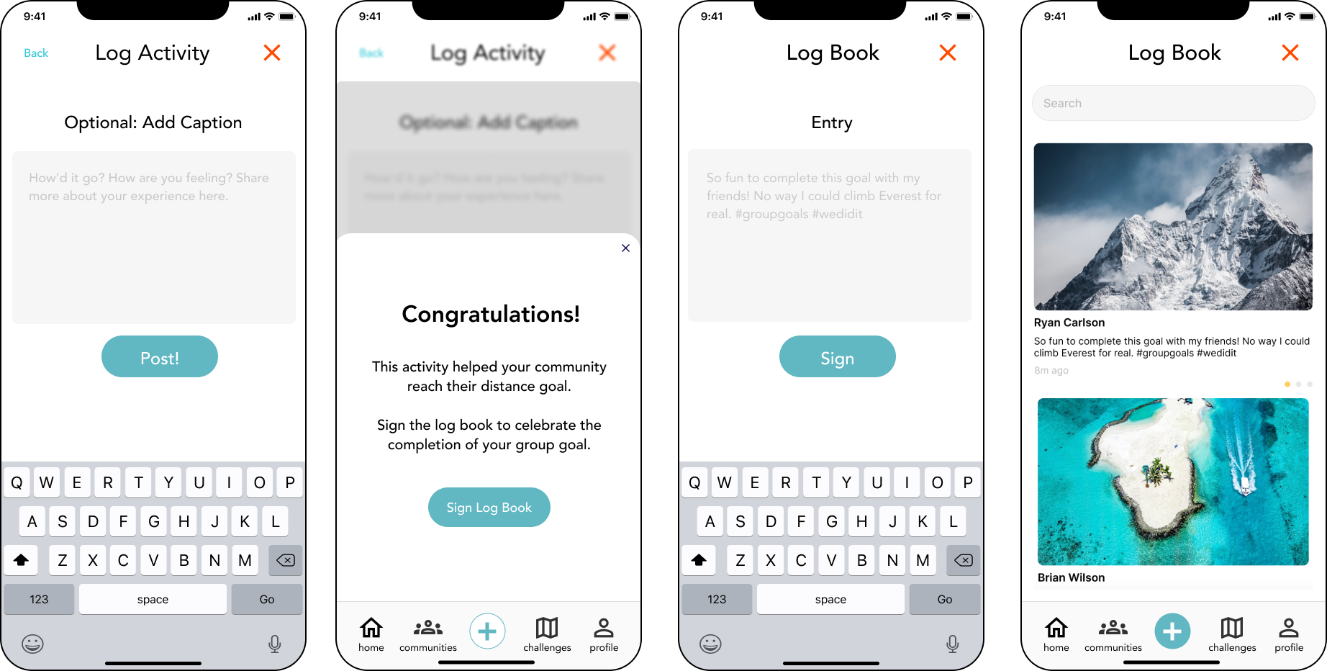
Task 1: Log a Physical Activity

Slide 25
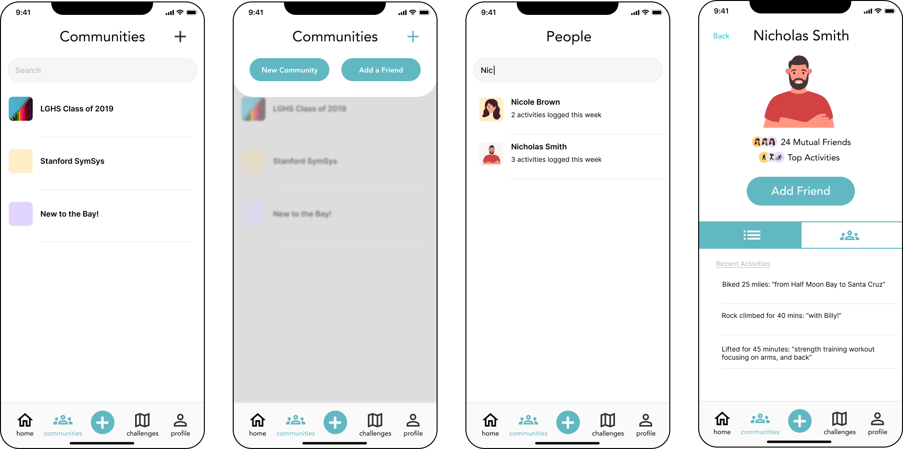
Task 2: Add A Friend

Slide 26
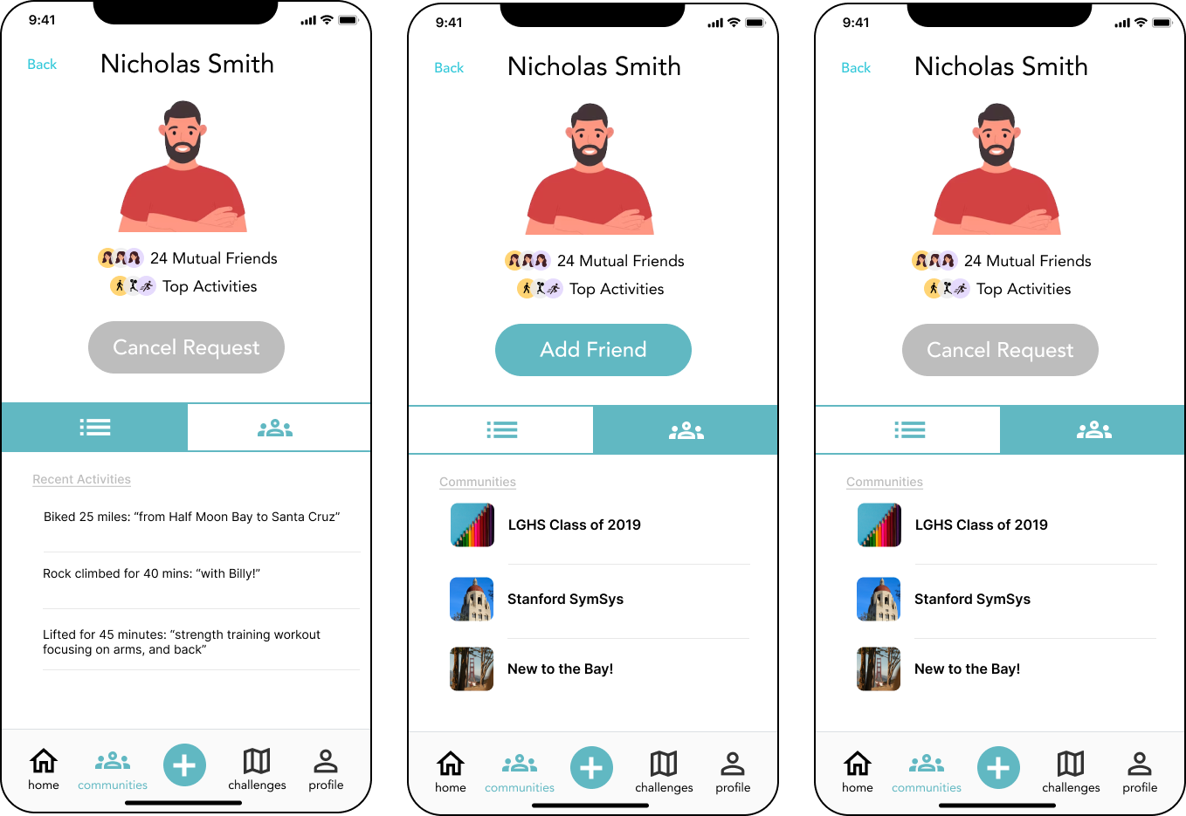
Task 2: Add A Friend

Slide 27
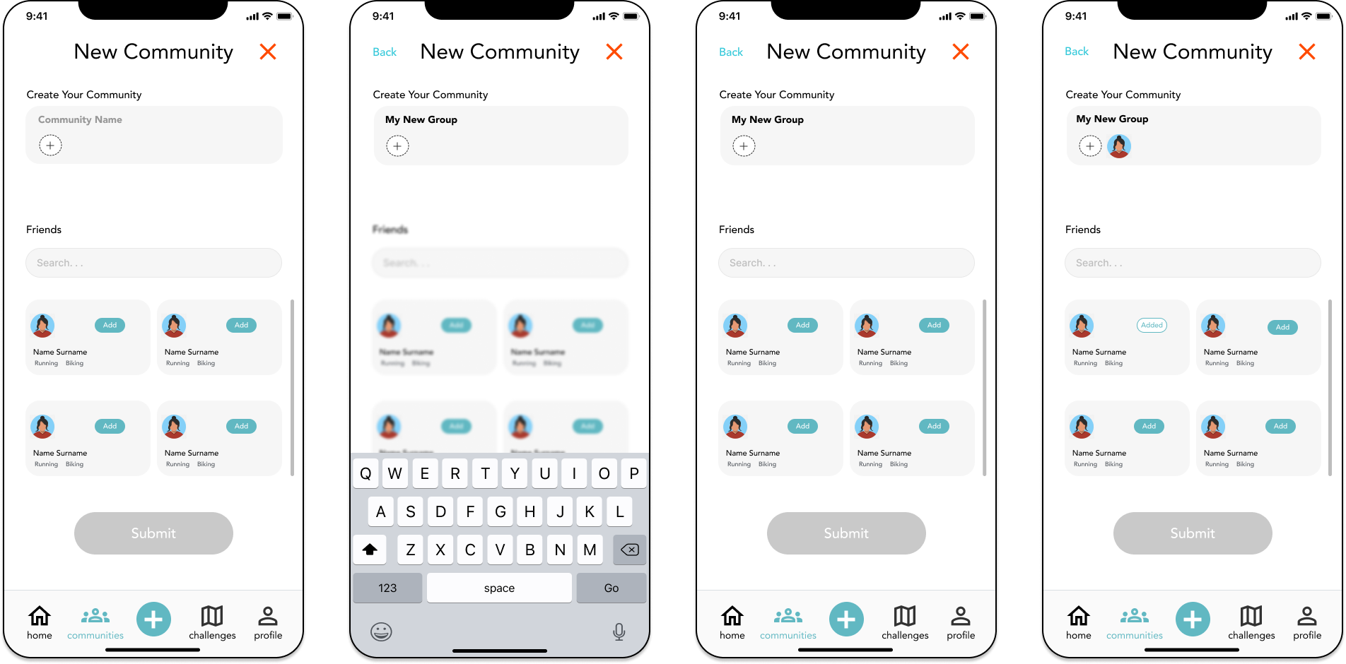
Task 3: Create A Community

Slide 28
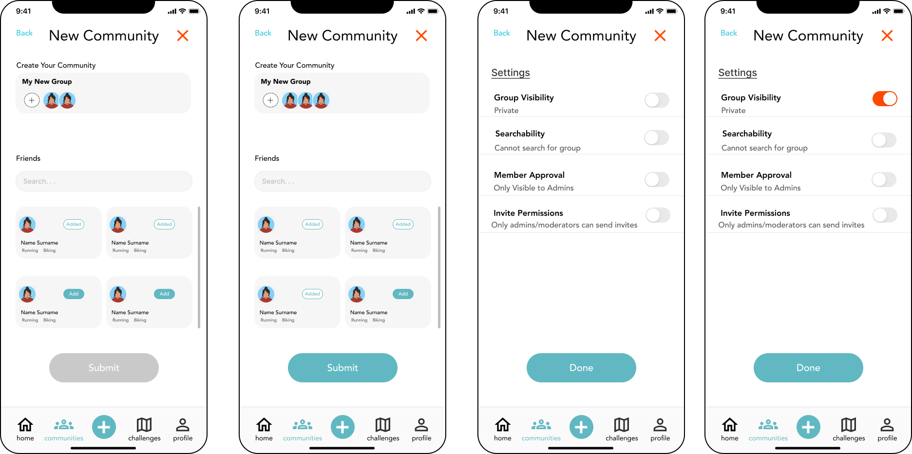
Task 3: Create A Community

Slide 29
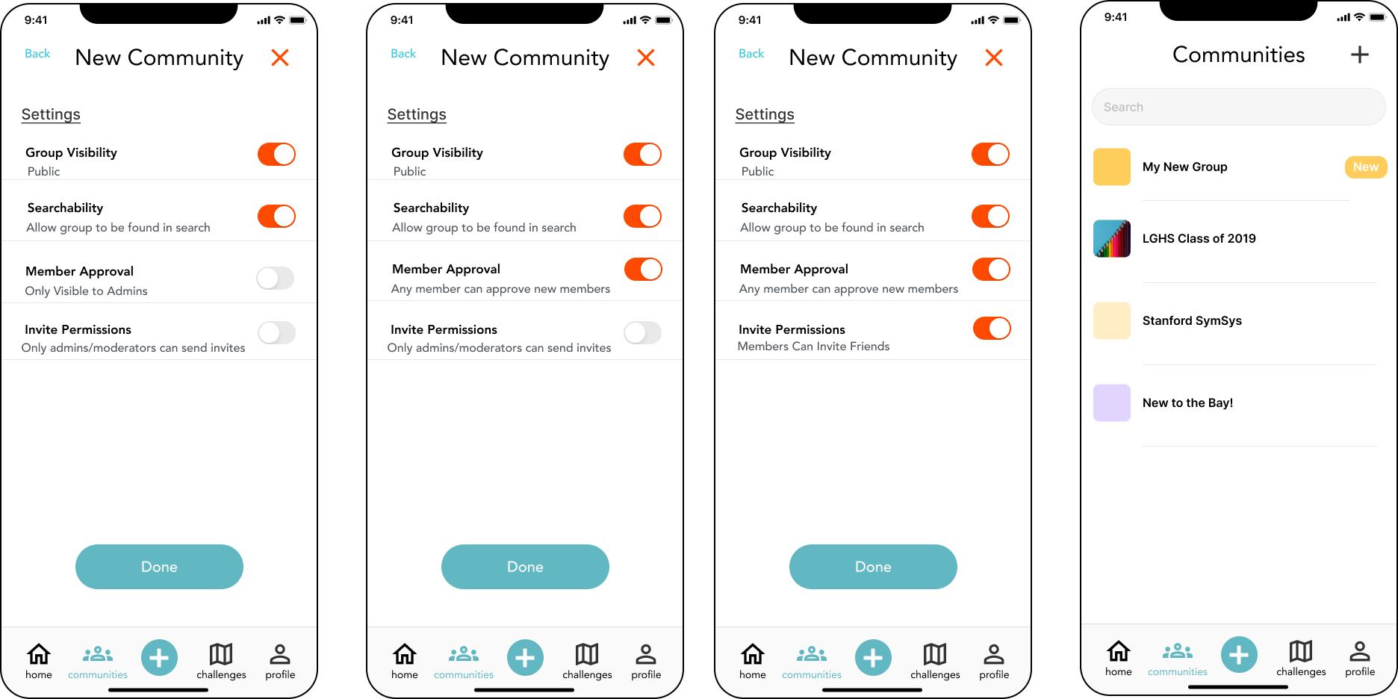
Task 3: Create A Community

Slide 30
08
Prototype Implementation

Slide 31
Figma
We implemented our medium-fidelity prototype on
Pros
Easy simulation of a device screen
Configurable tap events to trigger navigation to other pages
Easy to use reusable components
Material UI icons and other toolkits readily available on Figma
Cons
Lacks advanced capabilities for developer handoff and translation into high-fidelity prototyping
Relatively difficult learning curve
Difficult to prototype complex conditional logic statements

Slide 32
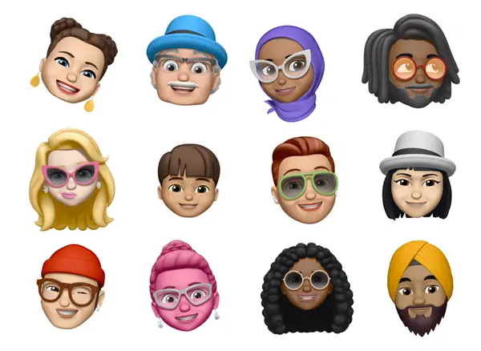
Limitations
Low use of logic and conditional flows for all our tasks because Figma cannot simulate database interactions
Our look and feel are mostly inline with our final design but our more complex visual effects and interactions cannot be properly captured
Figmas cannot simulate real API calls or backend processes – have to hard coded in user choices and selections
It is difficult to design a fully flushed out Profile page for multiple users with photos and/or Avatars – we made the choice to forgo a Profile screen in favor of increasing the fidelity of our chosen task flows

Slide 33
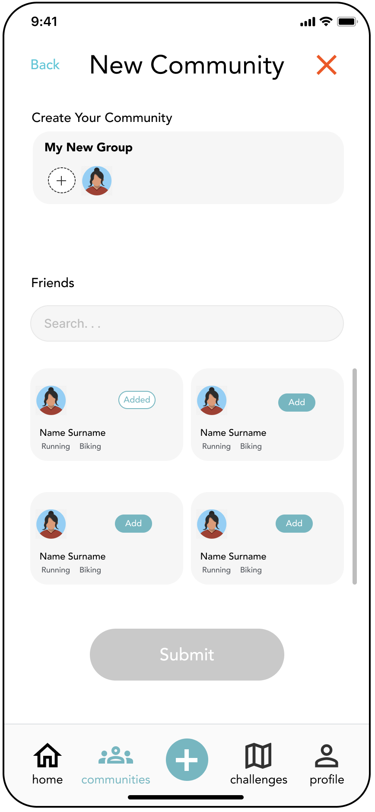
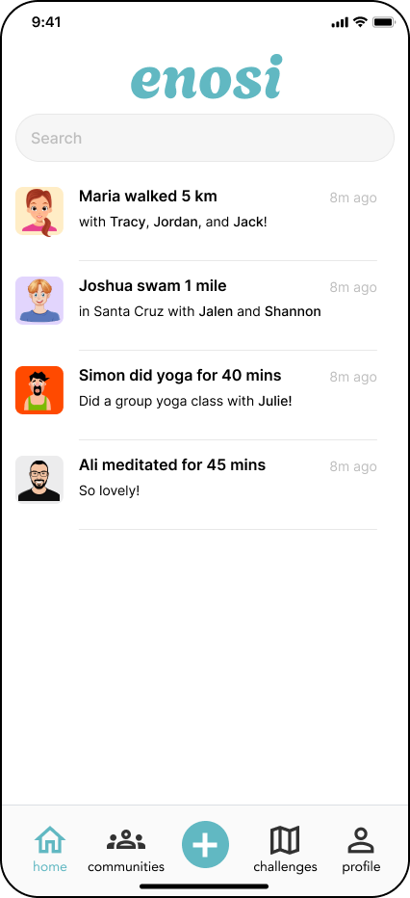
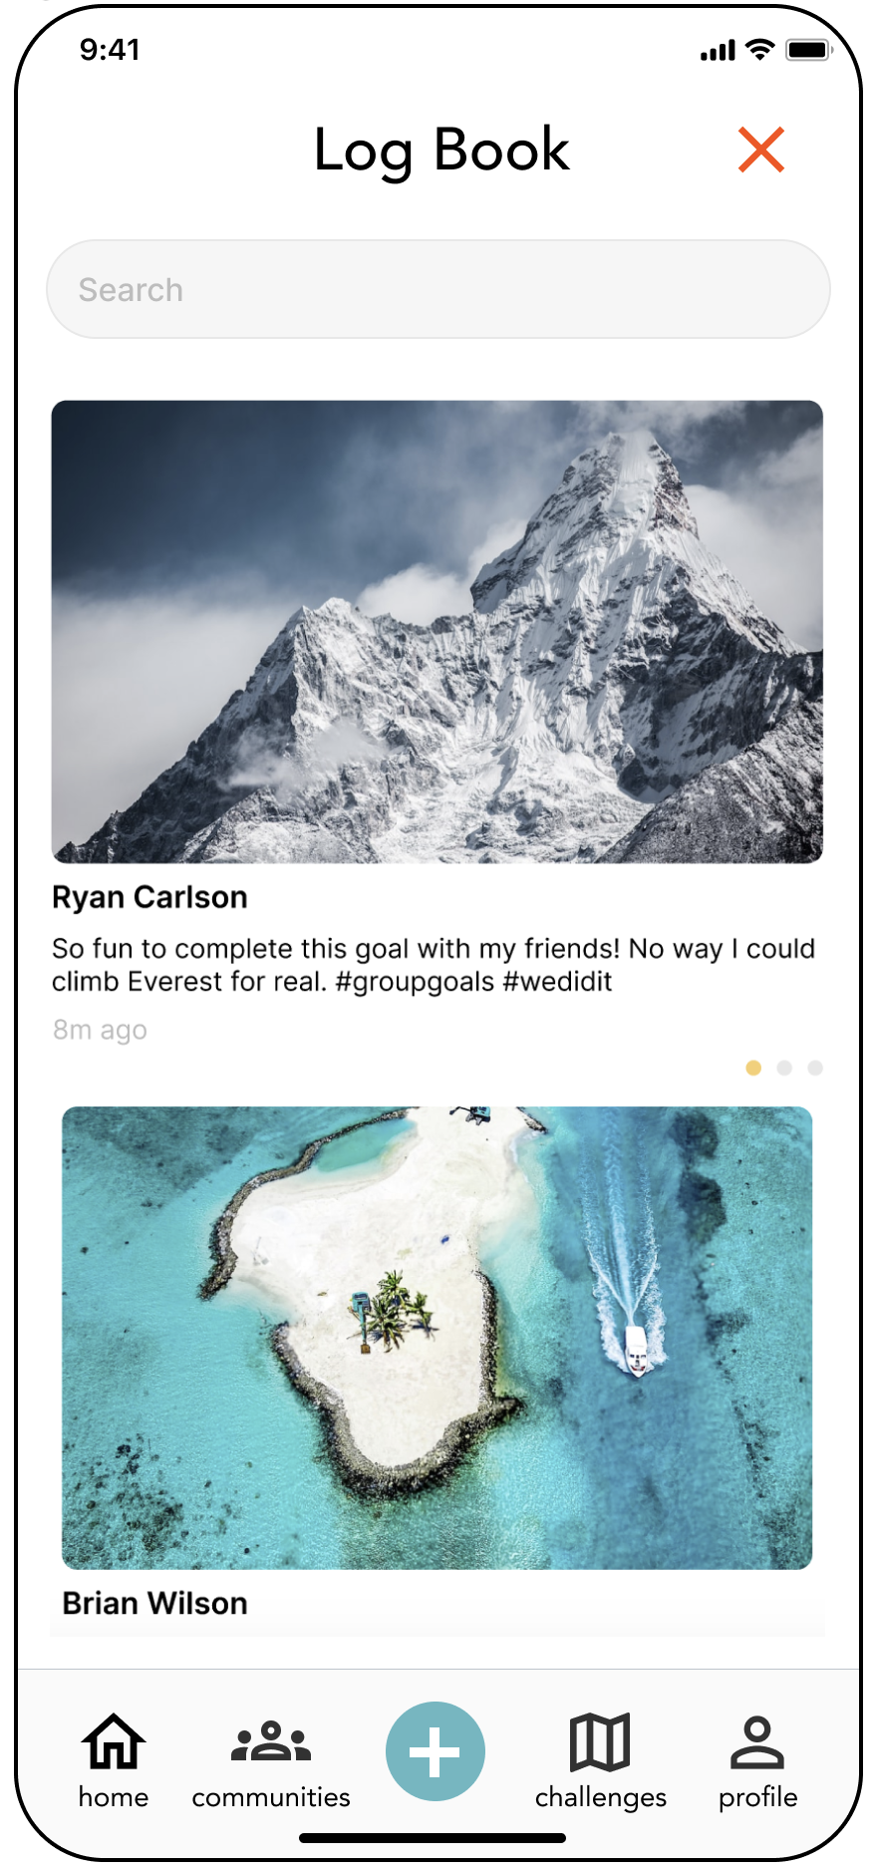
Enosi
Taking a closer look at our UI and UX mockups…
Hard Coded and/or Wizard of Oz Features
Home Profile: Sample user profiles and their recent activity logs
Logging an activity: Activity information
Log Book: Pre-populated entries in the logbook
Profile: A users mutual friendships, recent activities, and communities
Hard-coded data: activities, user directory, challenges, and communities
Wizard of Oz
X
Y
Z

Slide 34
09
Appendix

Slide 35
Interactive Figma Prototype
Med-Fi Figma
README

Slide 36
Thank you!

