Slide 1

Sketching, Low-fi Prototyping & Pilot Usability Testing
Notes:
Intro
Project title: Designing for an active lifestyle

Slide 2

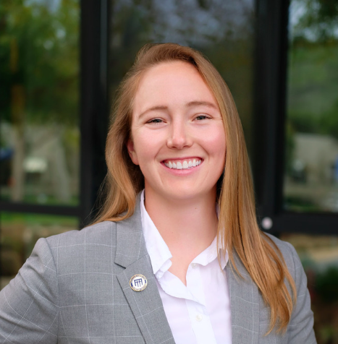
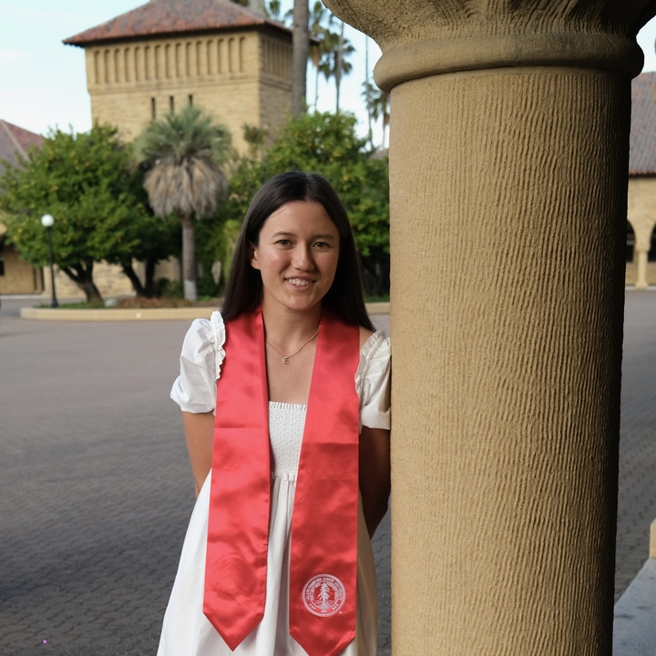
Our team:
Fahad
Nabi
Lyndsea Warkenthien
Elysia
Smyers
Notes:
Intro
Team Members

Slide 3
01
Introduction

Slide 4
Our platform is a community-focused platform designed for individuals undergoing lifestyle transitions. We prioritize physical and mental wellness by encouraging group-goal accomplishments, uniting people in their shared journey towards better well-being.
Value Proposition:
Our Mission Statement: A collective pursuit of well-being.
The Birth of Our Name: Derived from the Greek word, Enosis, which refers to the movement of communities that formed the modern political and social union of Greece
Notes:
Intro
Project title and team
Value Proposition
Problem/solution overview

Slide 5
Value Proposition:
Leverage the power of community to motivate, inspire, and drive progress. No one goes through a lifestyle or wellbeing change alone.

Slide 6
Problem Space:
Solution Space:
Lifestyle transitions can often be lonely, causing feelings of isolation, discouragement, and a sense of being overwhelmed
By setting shared goals, members can motivate and push each other forward, creating a snowball effect of positivity and progress

Slide 7
Roadmap
05
01
02
06
03
07
08
04
09
Low-fi prototype: 3 task flows
Introduction
Sketching Explorations
Testing methodology
Selected interface & rationale
Testing results
Discussion
Low-fi prototype construction
Appendix

Slide 8
02
Sketching Explorations

Slide 9
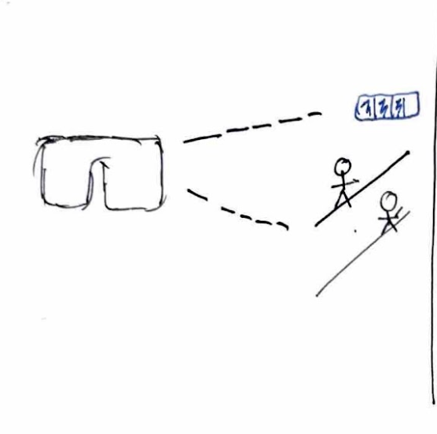
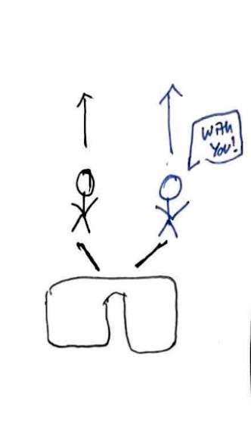
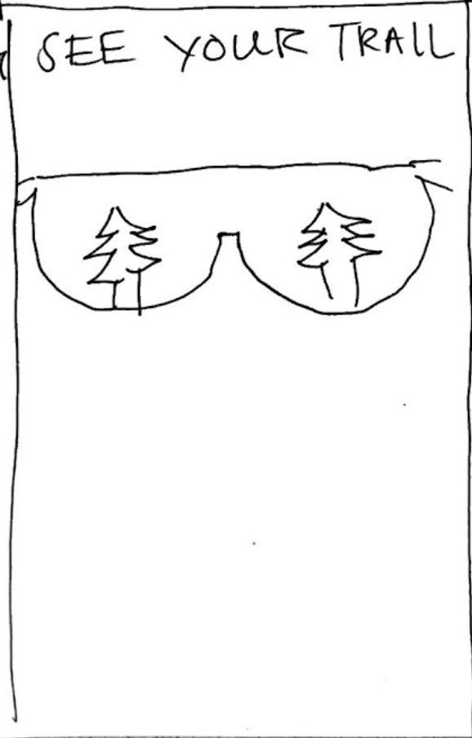
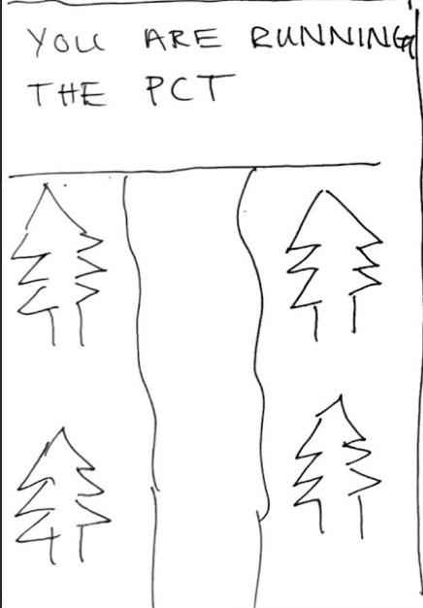
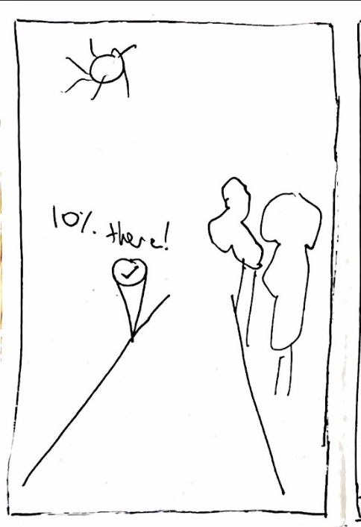
Explored Realization #1: AR/VR

Slide 10
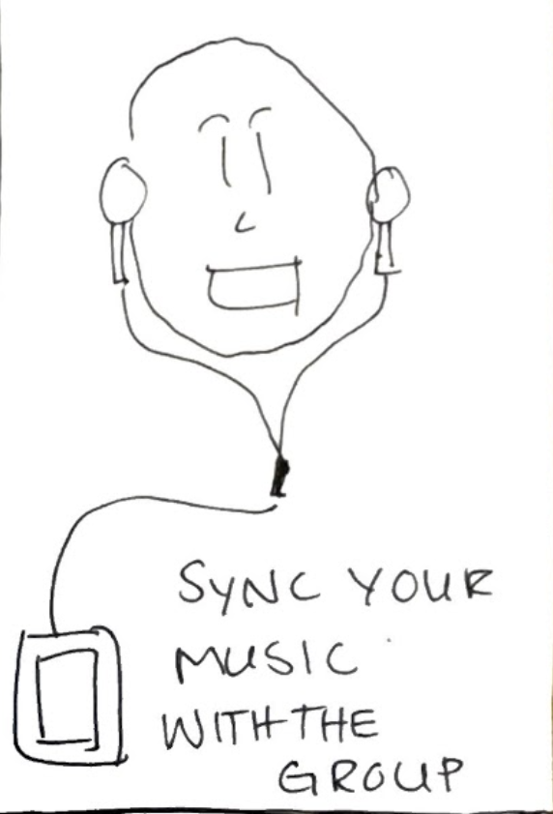
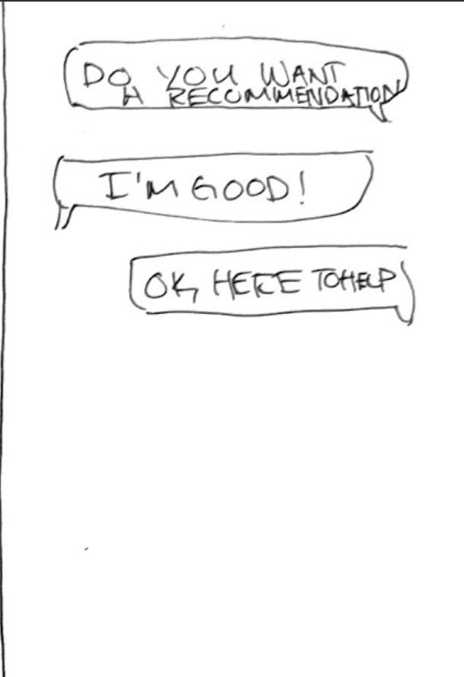
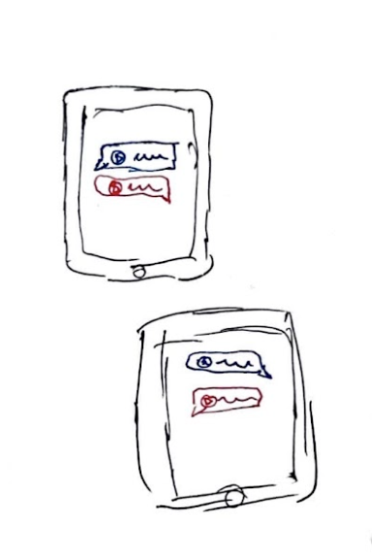
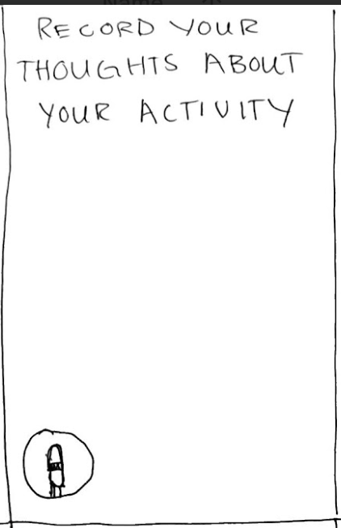
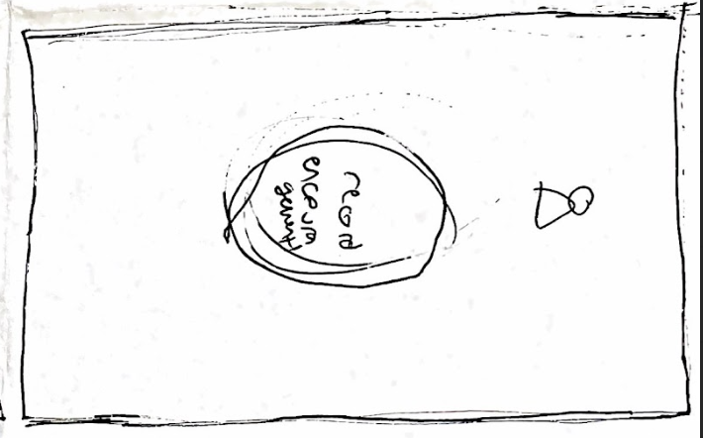
Explored Realization #2: Speech

Slide 11
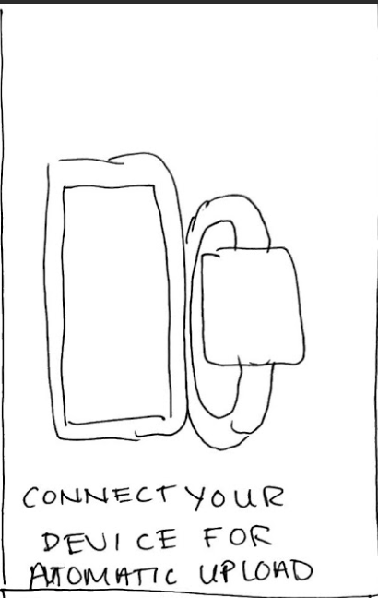
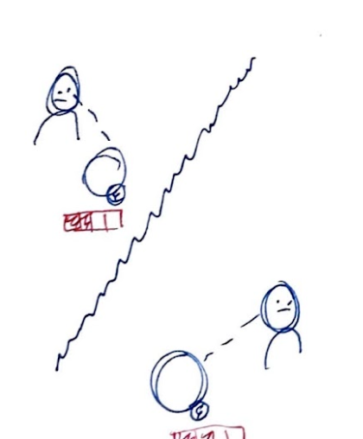
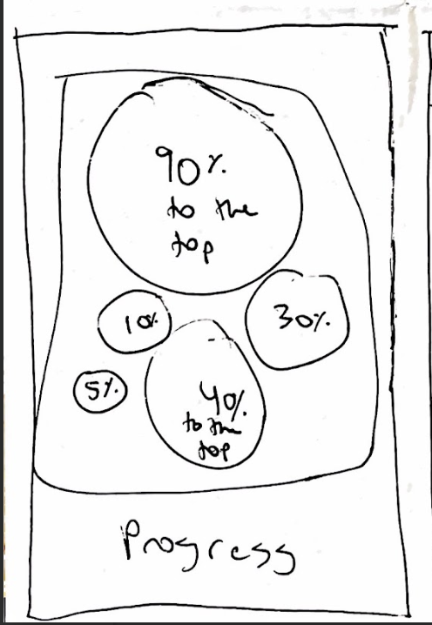
Explored Realization #3: Wearable

Slide 12
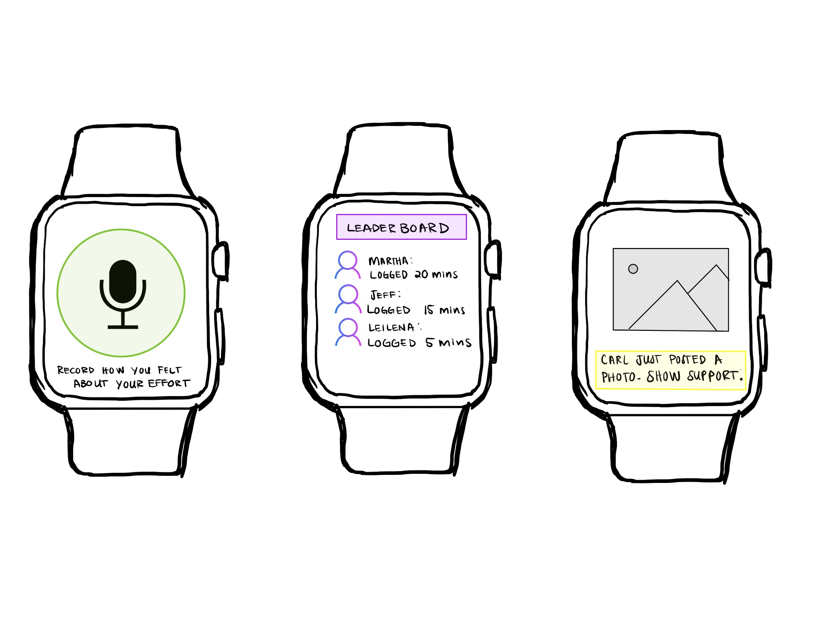
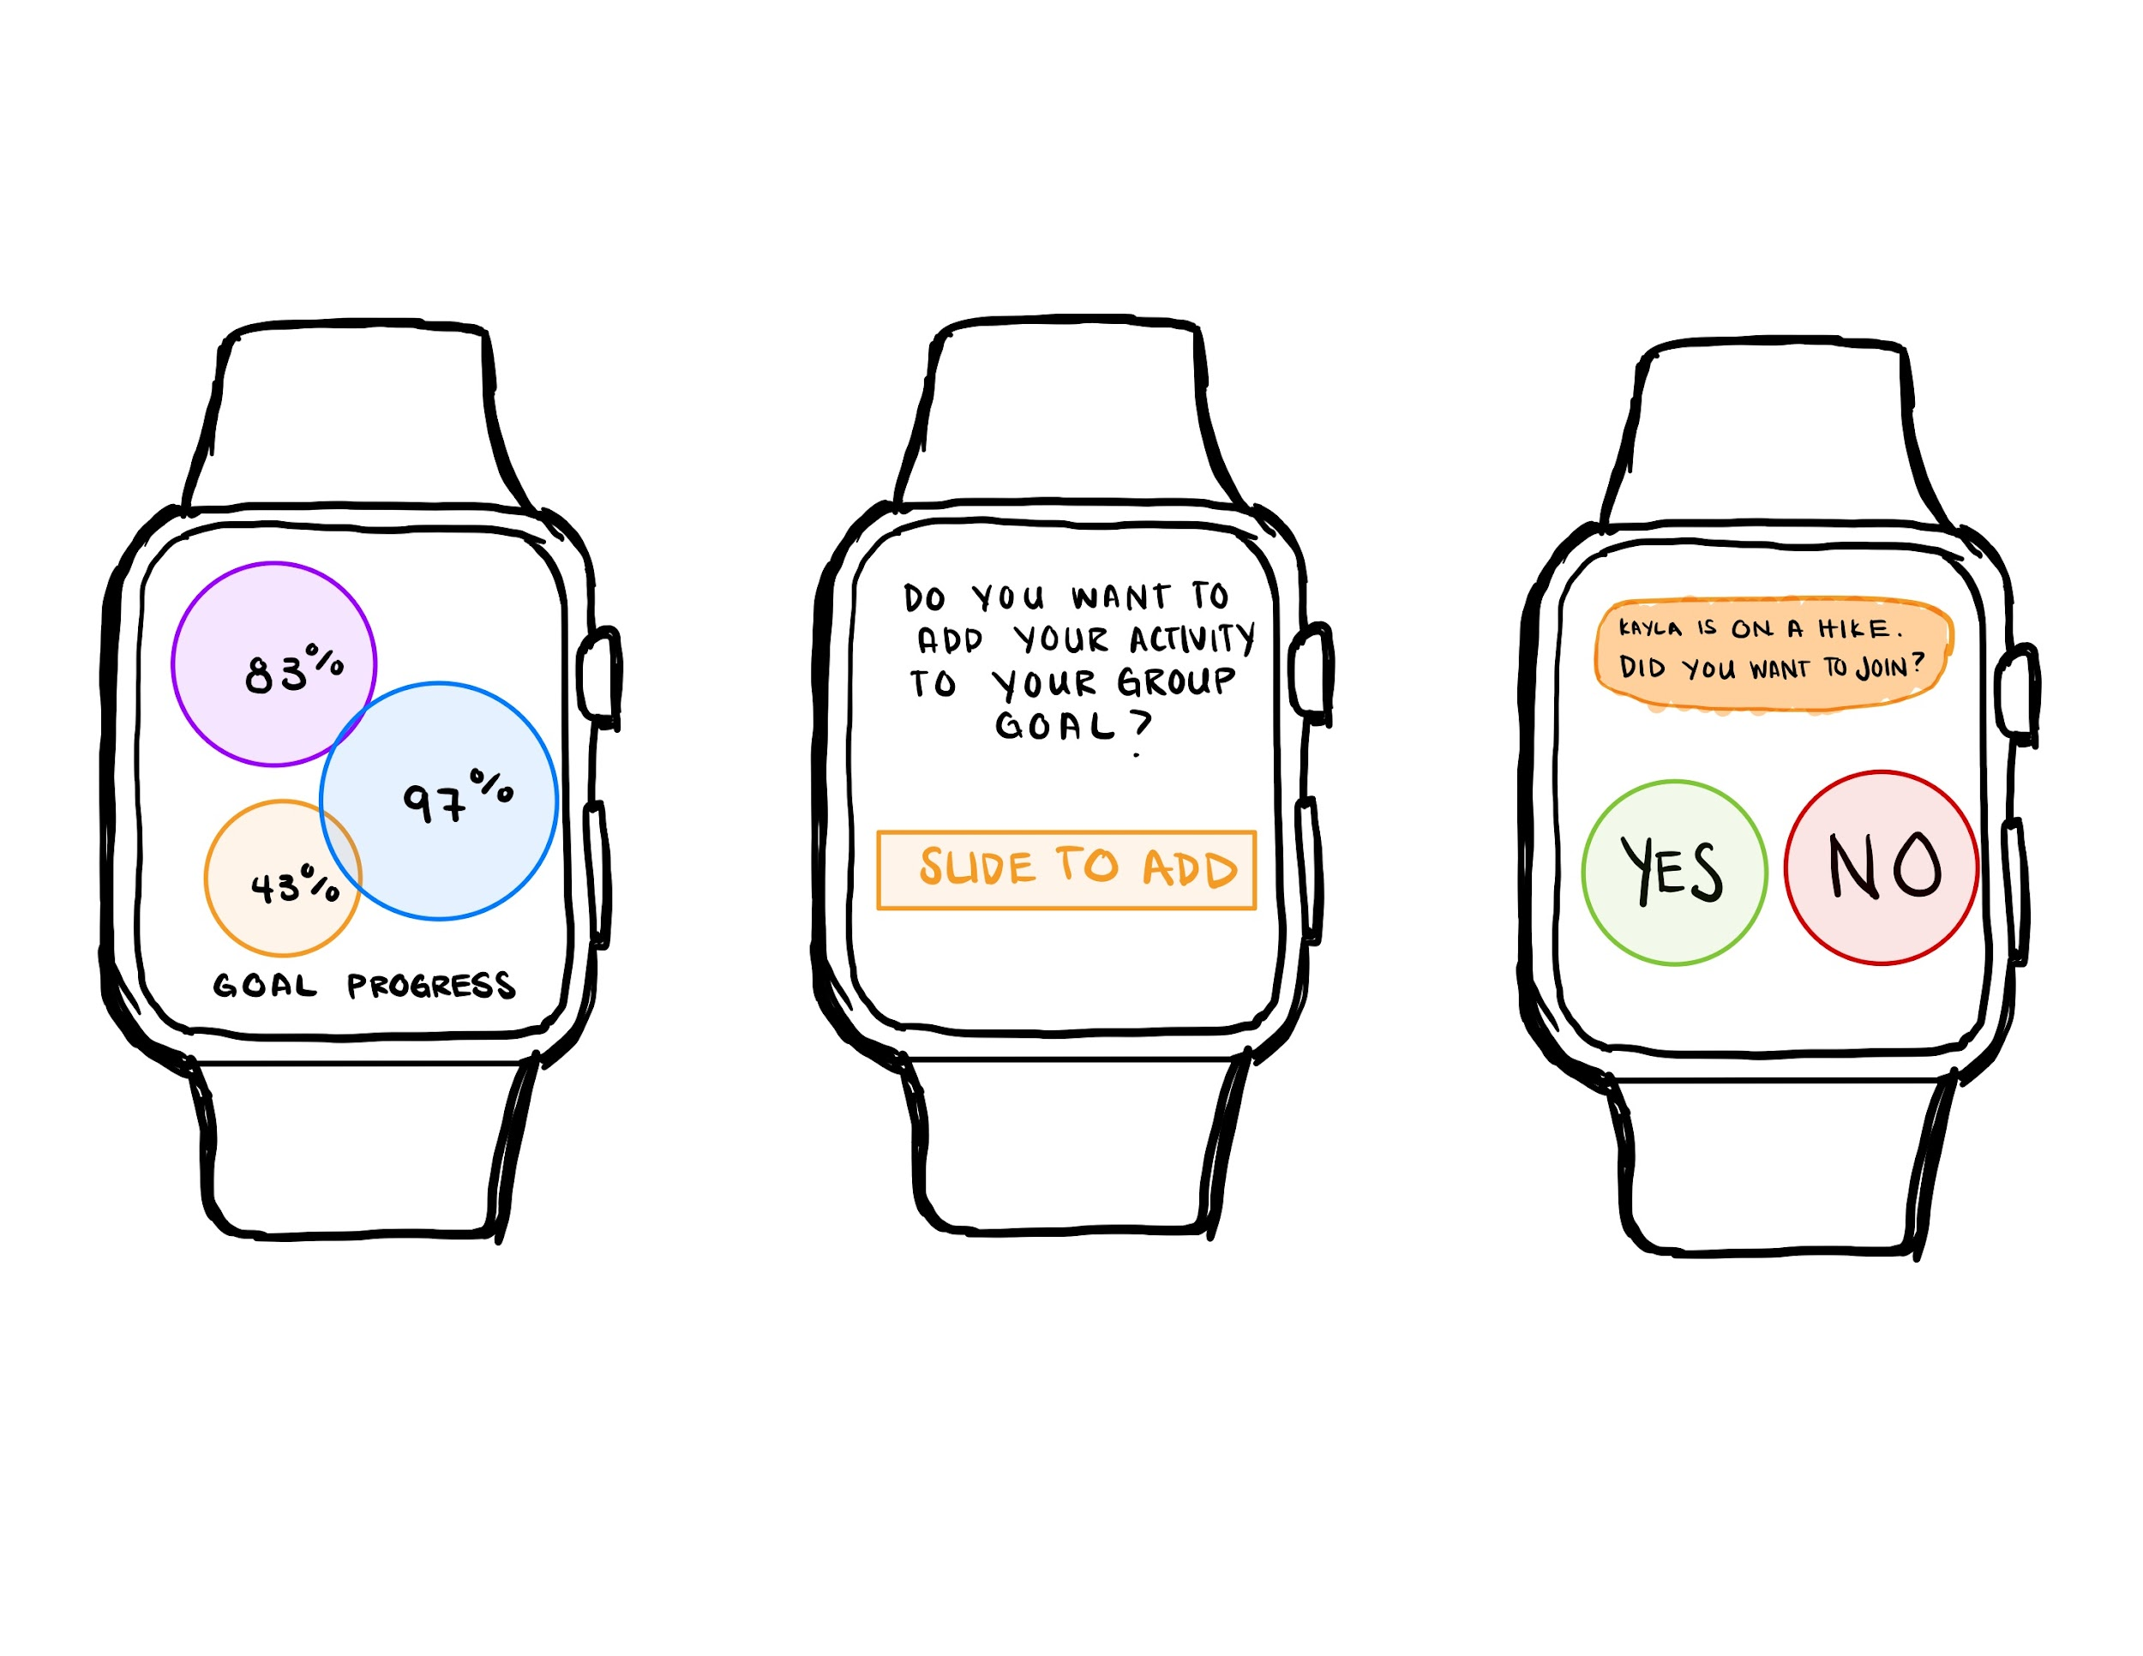
Fleshed Out Realization 1: Wearable

Slide 13
Wearable: Tradeoff Analysis
Pros
Integration with other health apps to broaden the ecosystem for the user
Physical devices can be physical reminders of users’ commitment to logging activities
Real-Time data collection
Cons
Affordability – wearables are an extra expense for users
Increase distraction that could cause additional stress for the users
Privacy risk – wearables allow for robust collection but that could be overwhelming to some users

Slide 14
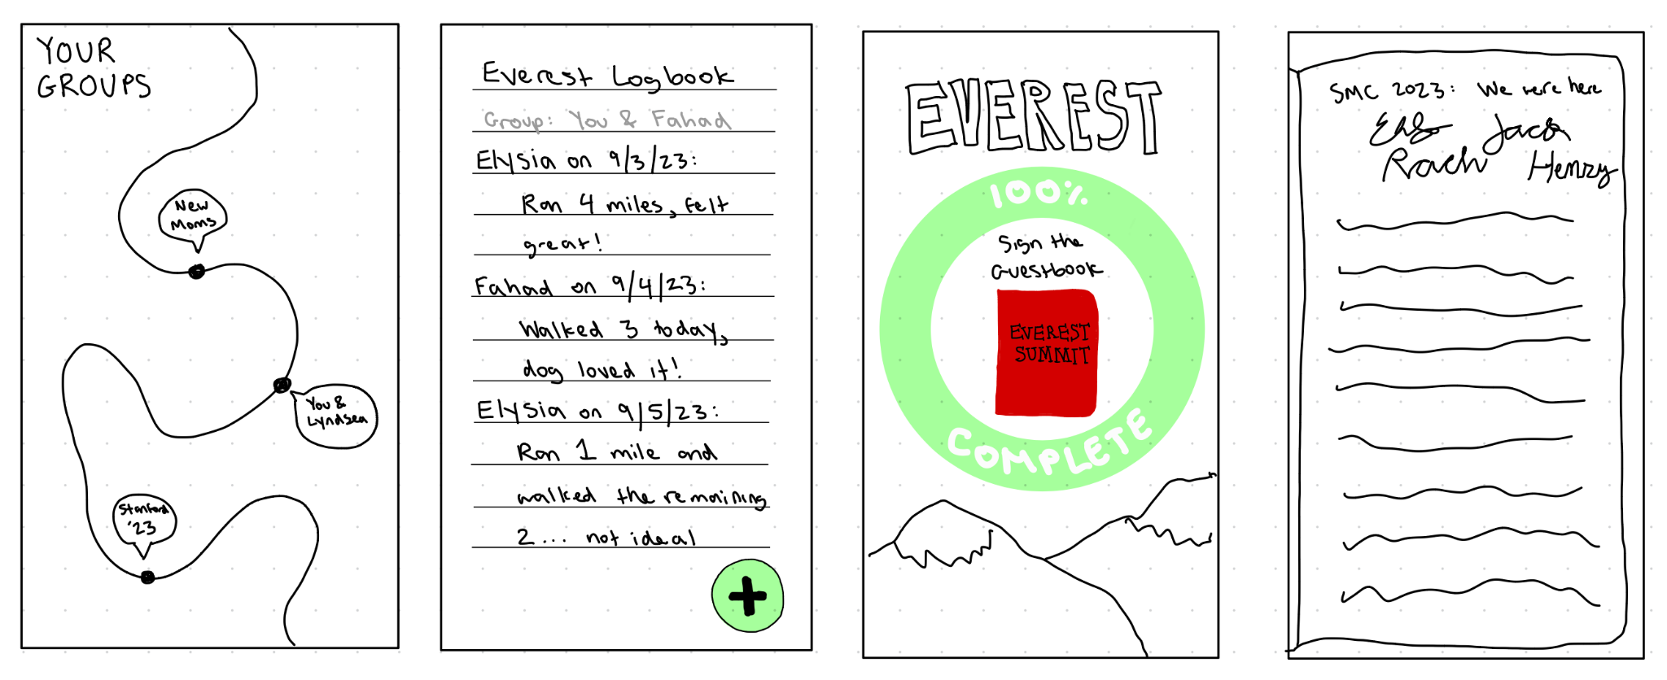
Fleshed Out Realization 2: Mobile App

Slide 15
Mobile App: Tradeoff Analysis
Pros
Adventure-focused representation that mimics the adventure aspects of outdoor activities -- minimizes data focus relative to other fitness apps
Prioritizes social aspects of outdoor activity; Community-centered platform which offers shared groups and promotes 1:1 interactions across group identities
Cons
Requires more manual logging of activity with qualitative notes rather than just automatic quantitative reporting
No real-time data collection
Possible for bad actors to populate guest books with negative/harmful content
Requires a lot of initial activation and user adoption from a diverse number of backgrounds/lifestyle transitions to truly make the social aspect work

Slide 16
03
Selected interface & rationale

Slide 17
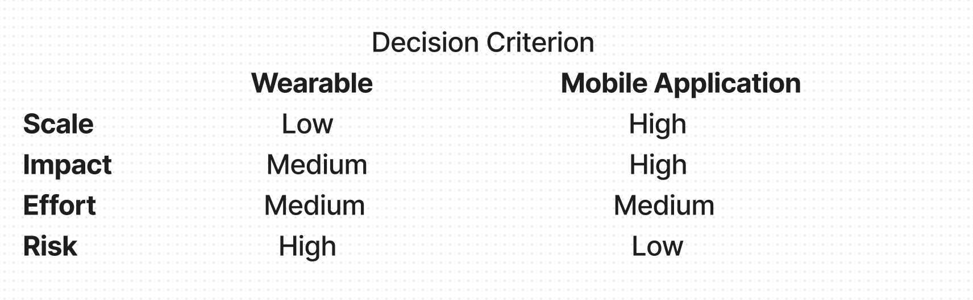
Selected interface: Mobile app
Although the wearable device would be a unique solution in our problem-space, a mobile application wins because it is much
easier to scale on cross-platform devices, provides people with the power to build greater communities and support networks and it is more accessible (i.e., fewer people have the means to afford a wearable device) , and requires less engineering effort as the application version can be continuously updated/launched to address tweaks.

Slide 18
04
Low-fi prototype construction

Slide 19
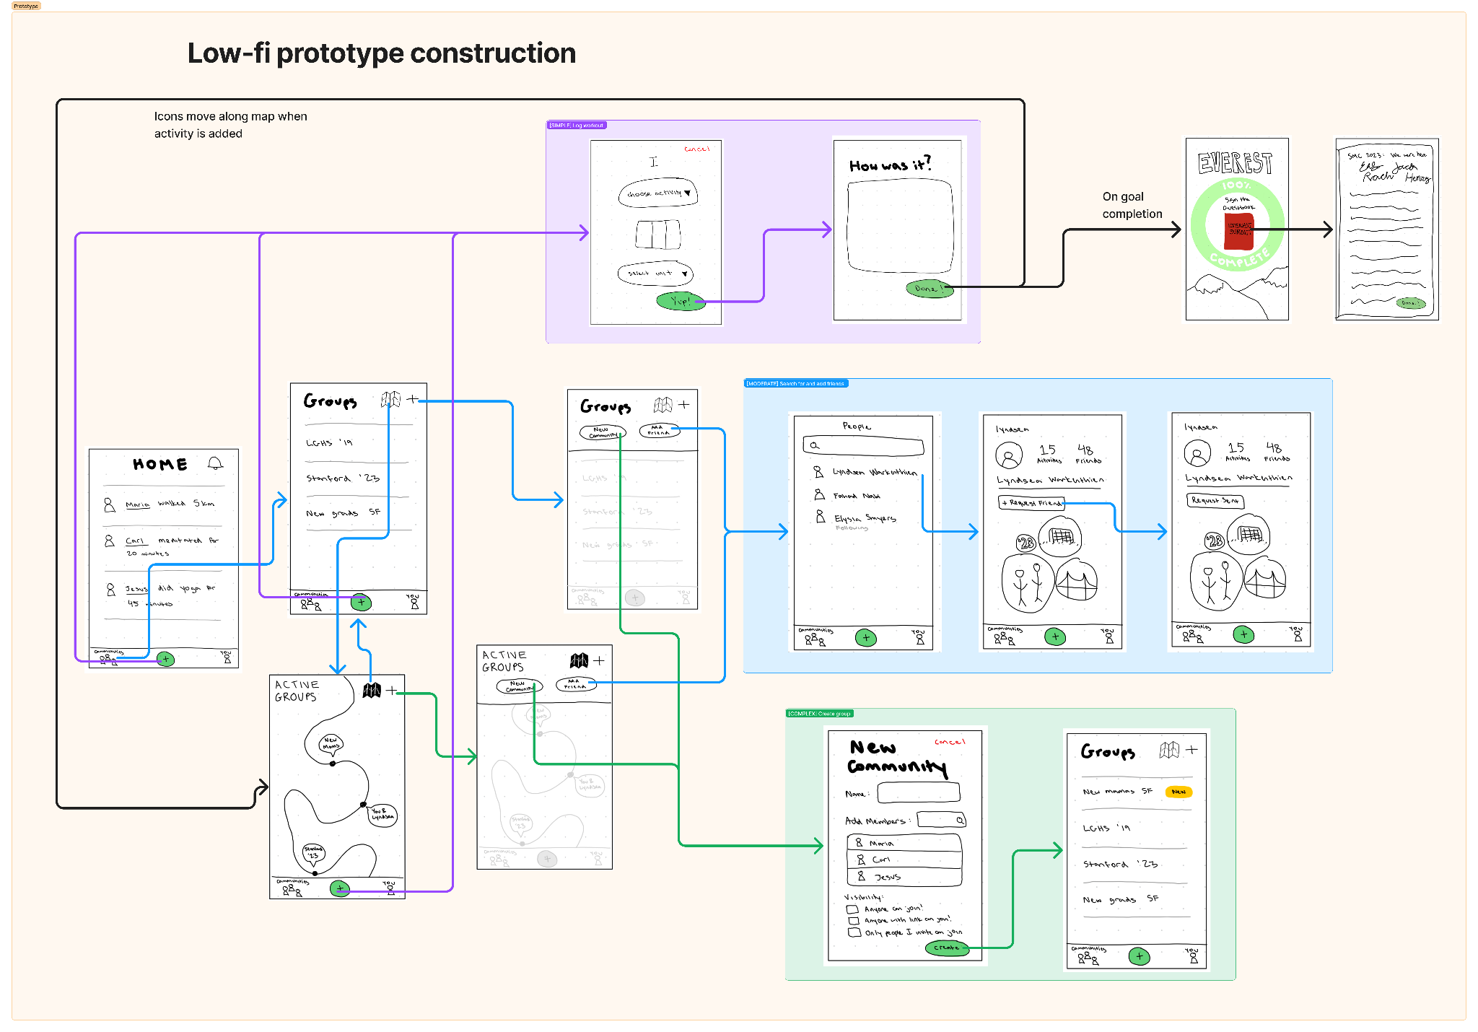

Slide 20
05
Low-fi prototype:
3 task flows

Slide 21
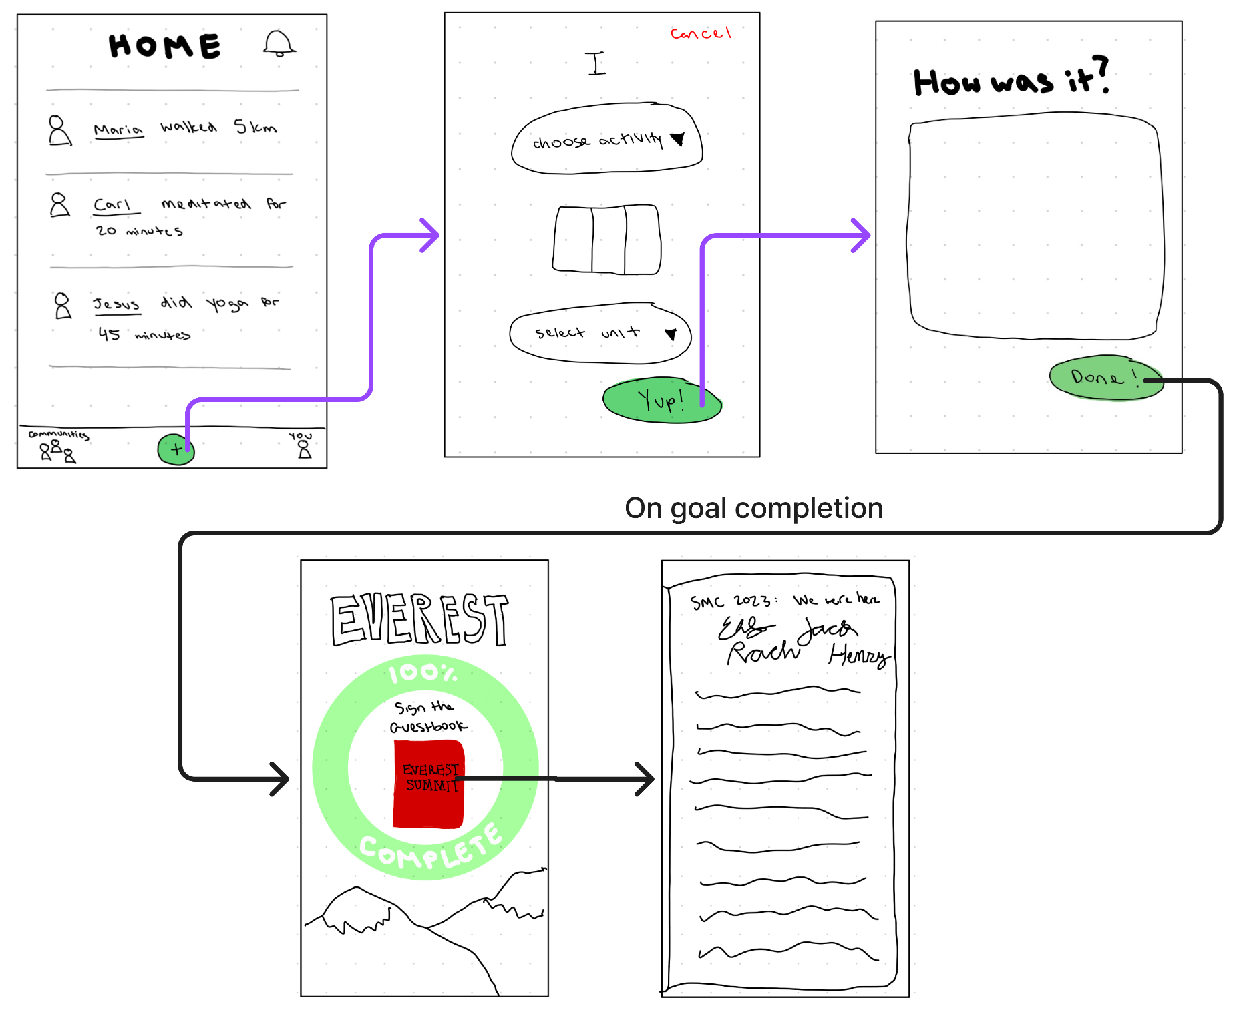
Simple Task: Log a Workout

Slide 22
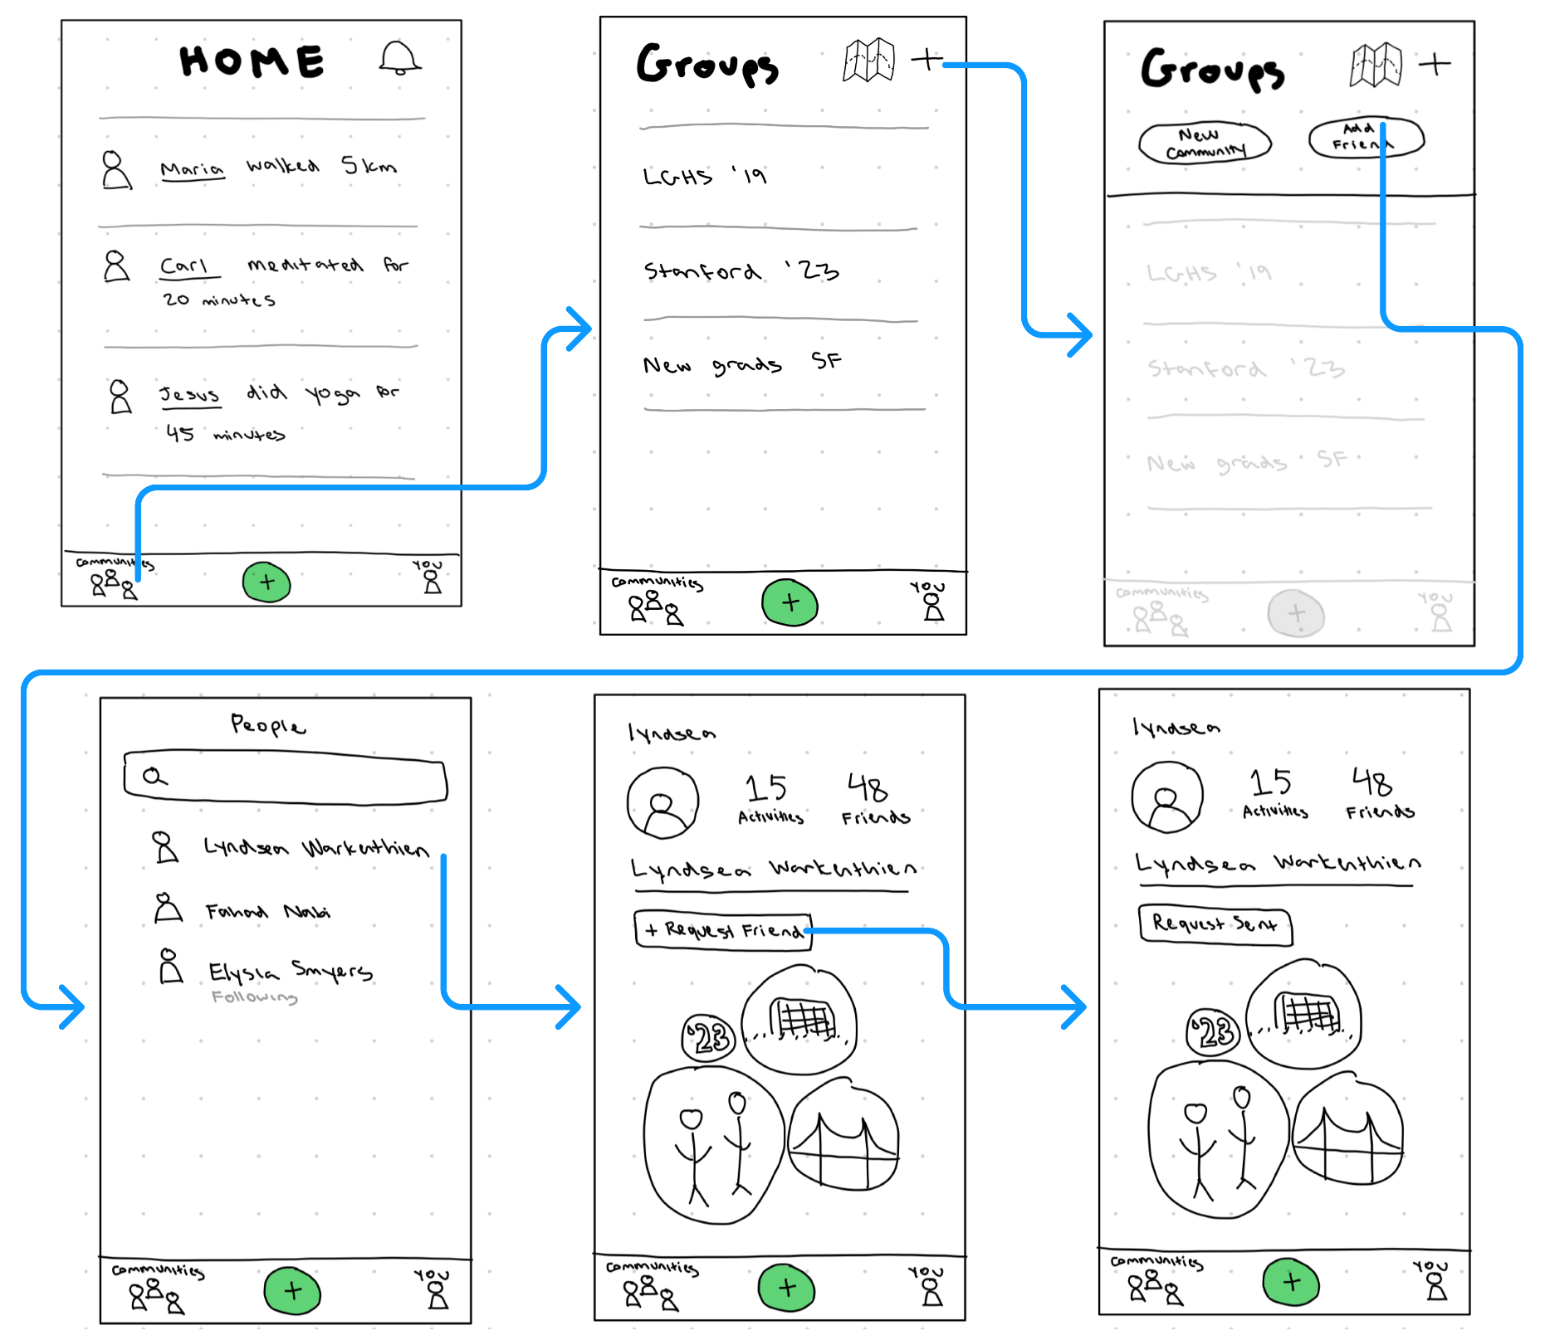
Moderate Task: Search for and add a friend

Slide 23
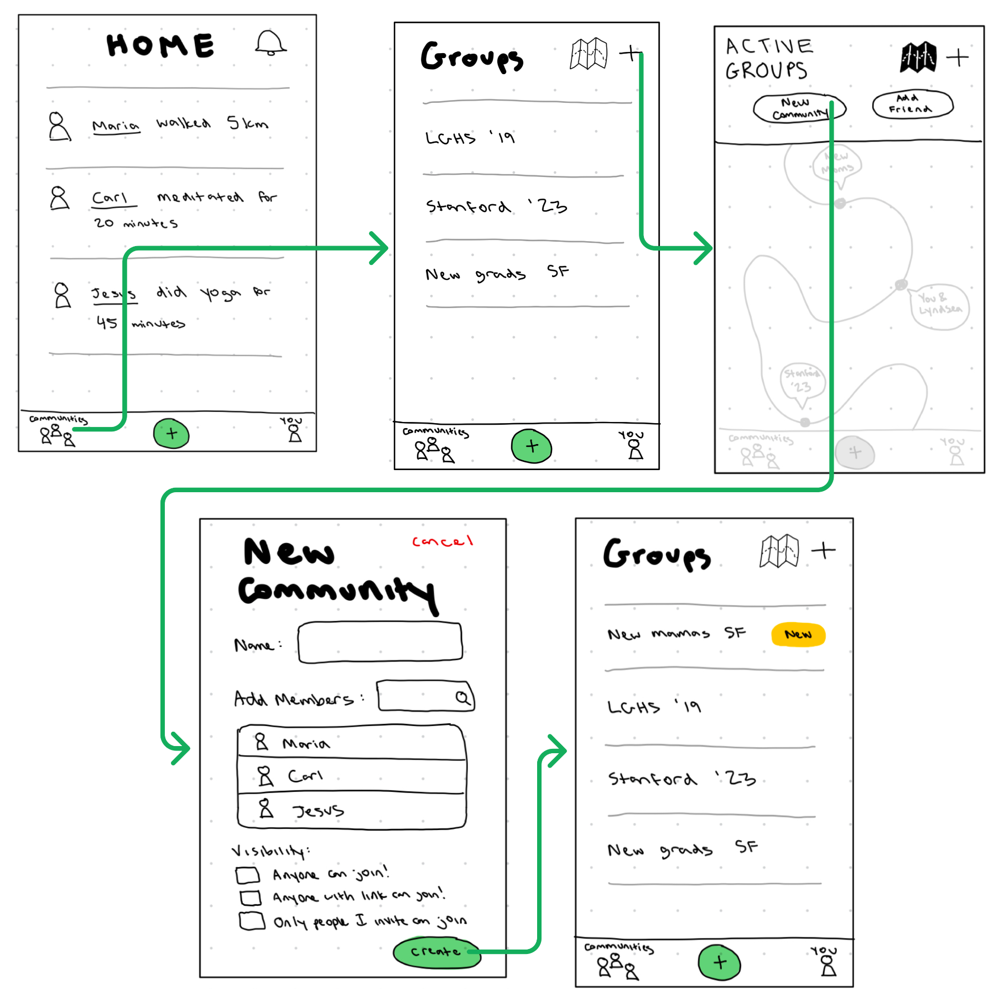
Complex Task: Create a group

Slide 24
06
Testing methodology

Slide 25

Participant selection:
Phyllis
New Hobby
Milton
New Pet Owner
Roger
Retirement
Diane
New Parent
She/Her, 70 Years Old
He/Him, 75 Years Old
He/Him, 58 Years Old
She/Her, 31 Years Old
*** All participants were recruited in person at the Stanford Shopping Center They were not compensated, but we tried to be mindful of their time during testing

Slide 26


Environment and Apparatus:
Lo-fi Prototype
iPhone for Voice Recording
iPhone for Photo Capture
iPad for Consent Forms
Stanford Shopping Center to get new user’s who are not familiar with the app

Slide 27
Procedure: team member roles
Fahad
Nabi
Computer
Facilitator
Lyndsea Warkenthien
Facilitator
Computer
Elysia
Smyers
Facilitator
Observer

Slide 28
Procedure: description of process
Give user the context of our Lo-Fi Prototype
Gather information about the participants (seeking participants with lifestyle change)
Present the premise of the prototype
Participants complete the 3 task as we noted their behaviors and verbal reactions
Gauge understanding of the app
Ask for reflection on functionality – What went right? What was unclear?
Asked for final feedback, any improvements we could make, answer any questions
Thank them for their participation

Slide 29
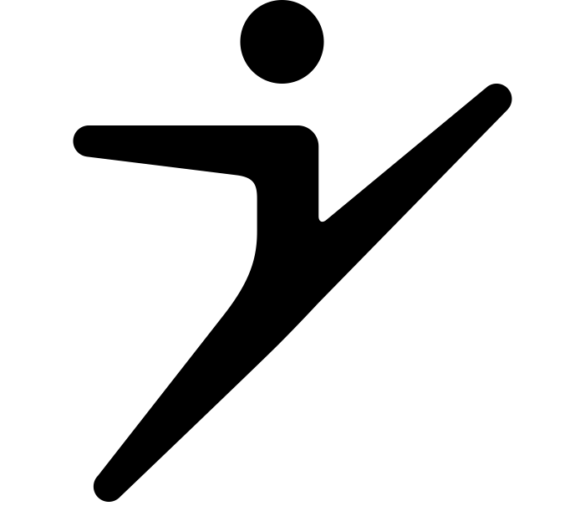

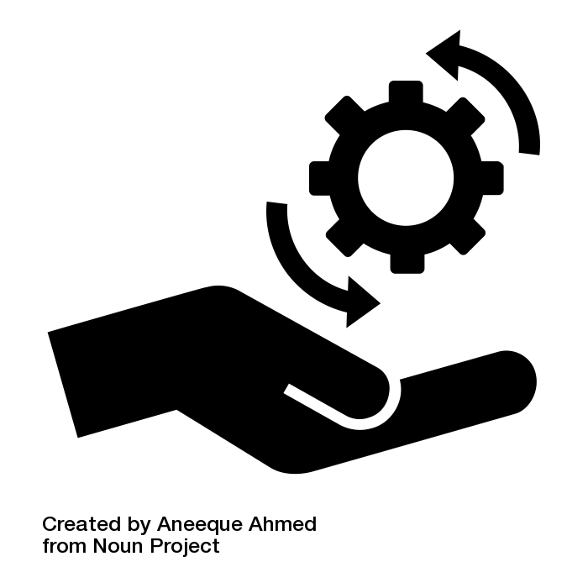
Usability goals:
Learnability: Faster 2nd time logging activities
Fun: Does the user have fun signing the guest book of a goal
Efficient: Performing the task does not waste effort and easy to complete

Slide 30
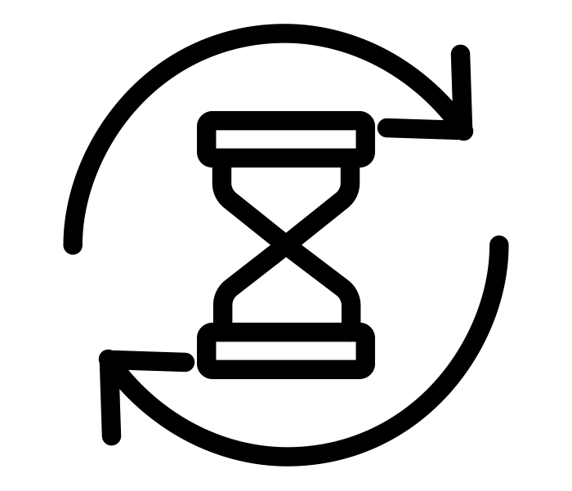
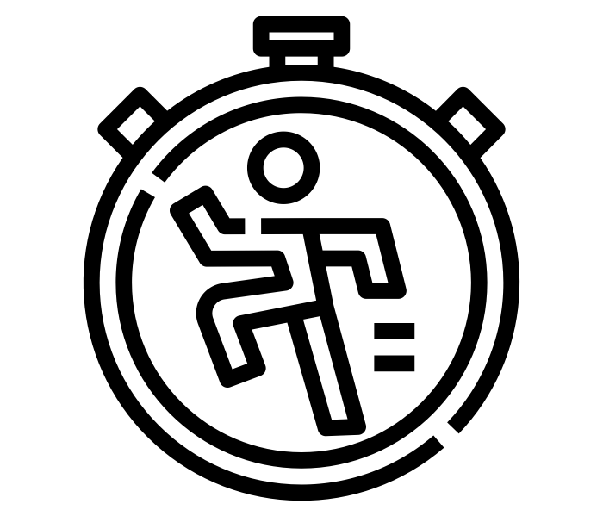

Key measurements
Fun Key Metric
(Yes/No Binary):
Does the participant have fun signing the guest book?
Learnability Key Metric (Minutes/Seconds):
Task Completion Time?
Efficiency Key Metric (Scale 1-5):
How easy is the task to complete?

Slide 31
07
Testing results

Slide 32
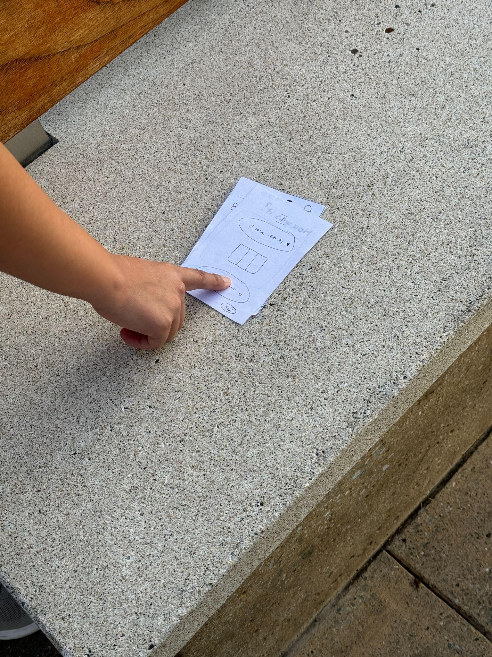
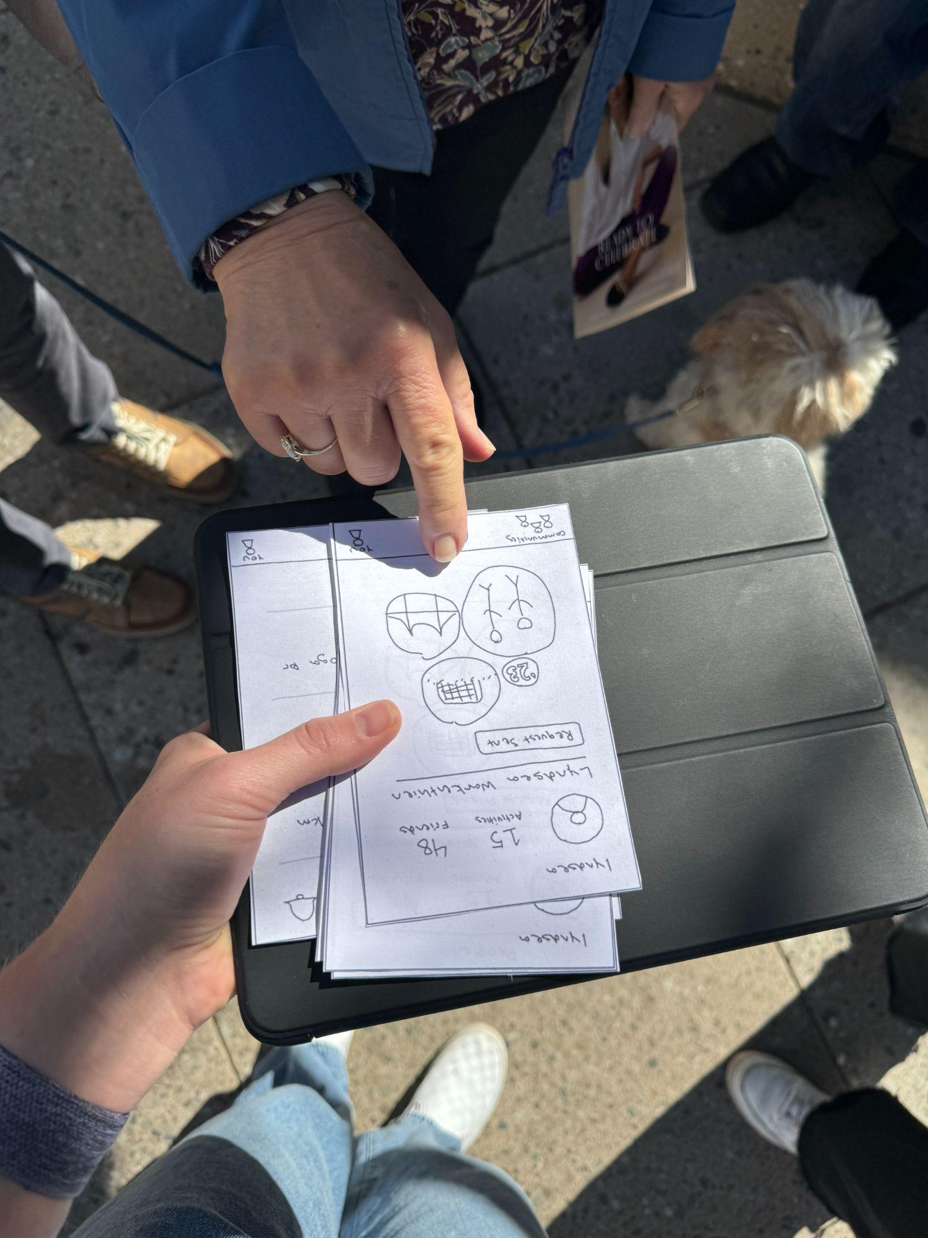
Process data (Big Picture Happenings):
Participants
Phyllis - New Hobby (Yoga)
Milton - New Pet
Roger - Newly Retired
Diane - New Parent
Phyllis, Milton, Roger are friends.
Behaviors
Demonstrated curiosity of the application (i.e, like a game)
Asked several questions pertaining to their hobby and making friends
Insights
Need for Encouragement to Try Something New
Contextualized the app to align with their own goals of improvement

Slide 33

Bottom-line data:
Usability Goal: Fun
Key Metric: Binary (Yes/No)
Result: All participants found signing the guestbook fun after task completion
Usability Goal: Learnability
Key Metric: Task completion time
Result: Average decrease of 3 seconds on repeated task completion (Noted possible skew due to group testing with Phyllis)
Usability Goal: Efficiency
Key Metric: Ease of completing tasks on a scale of 1-5
Result: Varied feedback, with some tasks deemed less intuitive by Phyllis and Milton

Slide 34

Other relevant observations:
Positive reinforcement from group testing may have influenced results
Task of searching and adding friends found less intuitive by some participants

Slide 35
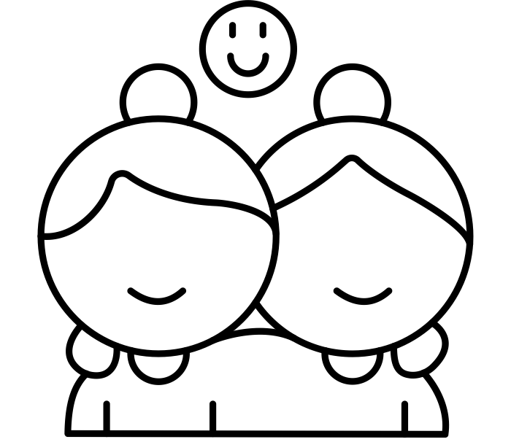
Achieve usability goals on key measures:
Overall positive response to the fun factor in the app
Learnability seems improved upon repetition, though group influence must be considered
Some efficiency issues highlighted, especially concerning friend features

Slide 36
08
Discussion

Slide 37
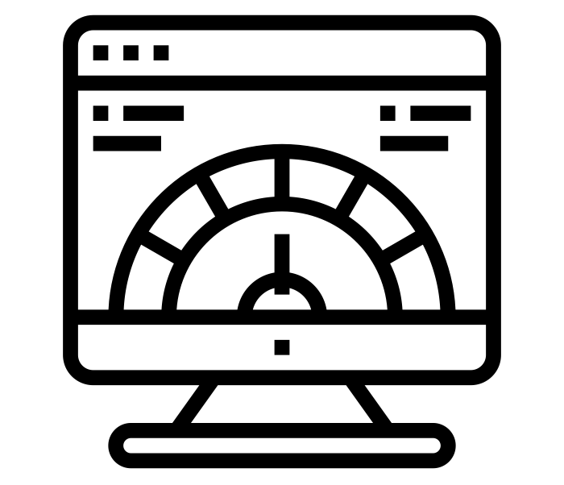
Implications of our findings:
The application offers an engaging experience (evidenced by the fun metric)
Users can adapt and learn features quickly
Friend-related functionalities might need improvement for more intuitive navigation

Slide 38
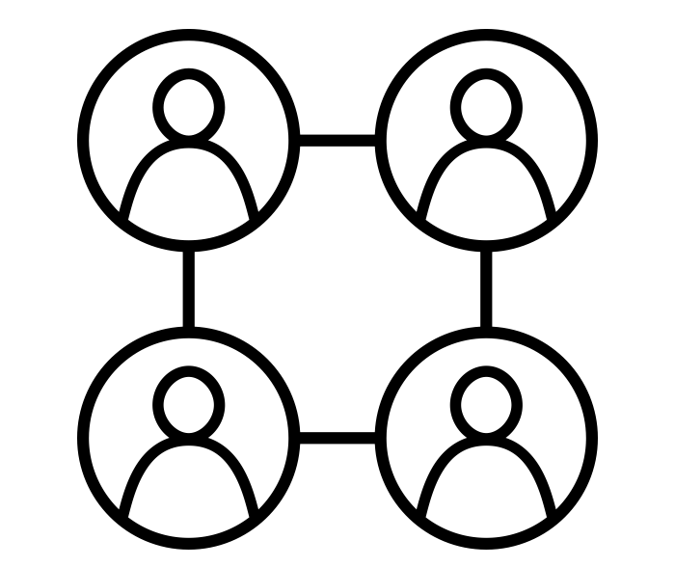

Next Steps (results for design changes):
Enhance clarity for addition features, possibly by redesigning buttons or providing clearer instructions
Clarify friend searching and adding friends
Use color for guidance and “click” feedback
Decrease dwell time on profile screen to increase exploration of rest of app

Slide 39
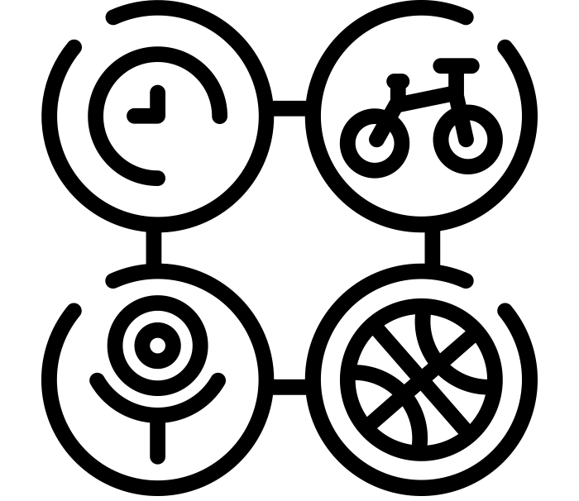
What testing couldn’t reveal:
Testing cannot tell us about the motivation it takes to pursue activities/hobbies
Need for broader user testing to generalize feedback, especially considering the variance in feedback between participants like Diane and the group
Lo-fi testing cannot tell us about habit formation

Slide 40
Thank you!

Slide 41
09
Appendix

Slide 42
FigJam
Critical Incident Log
Consent Forms
Helpful Icons for Slides

