Slide 1

needfinding:
designing for active lifestyles
individuals in transition
october 2023

Slide 2


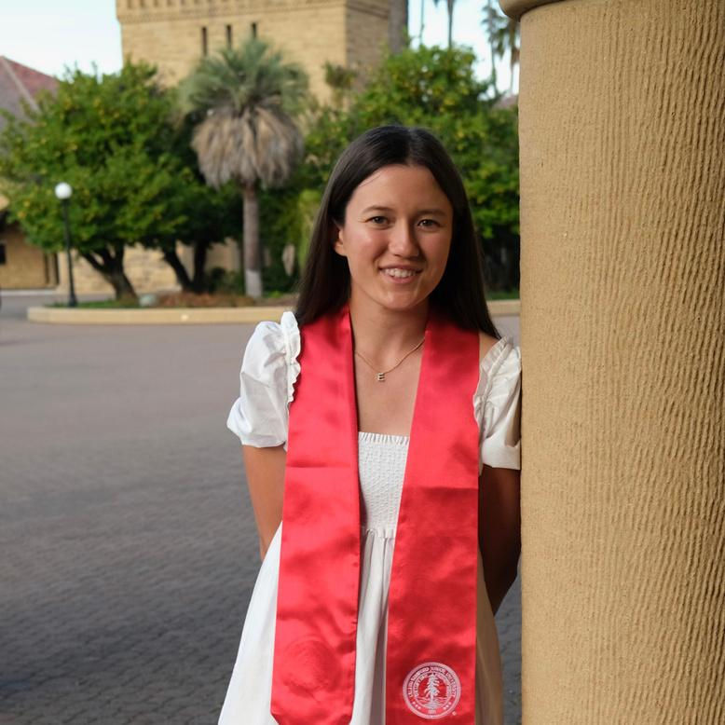
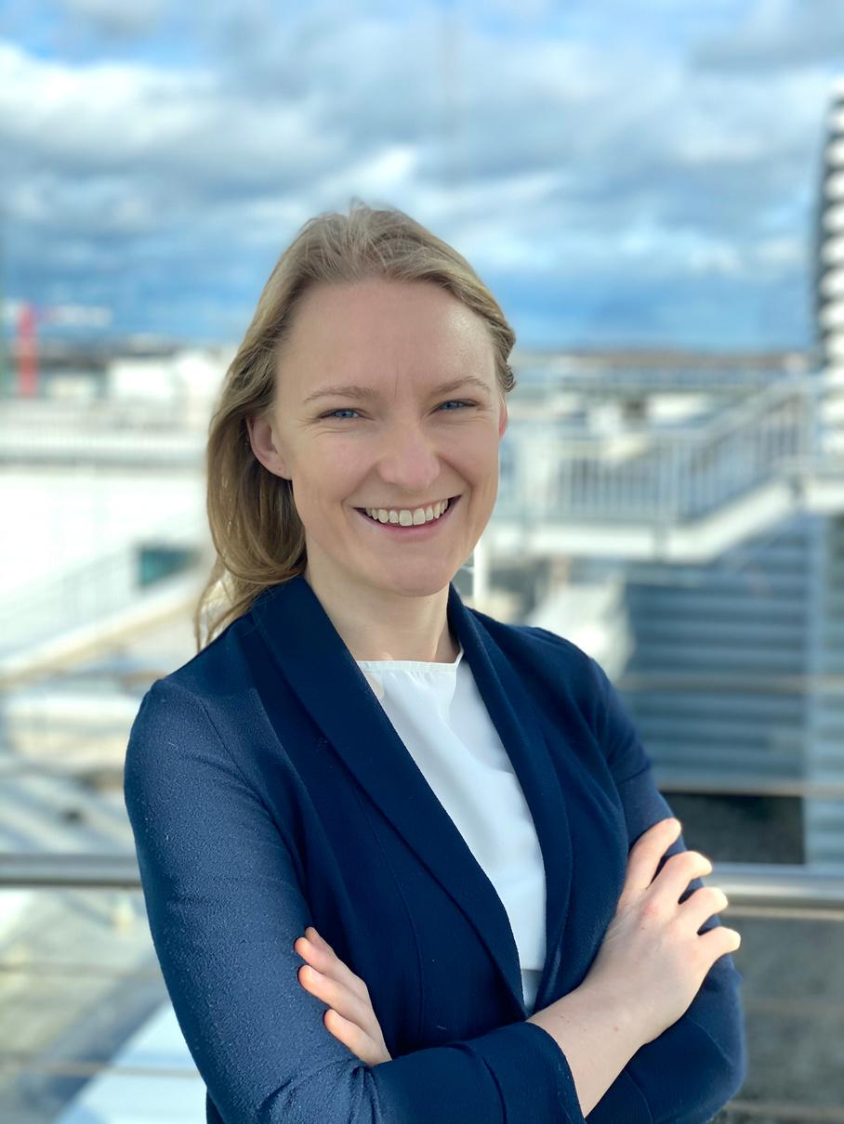
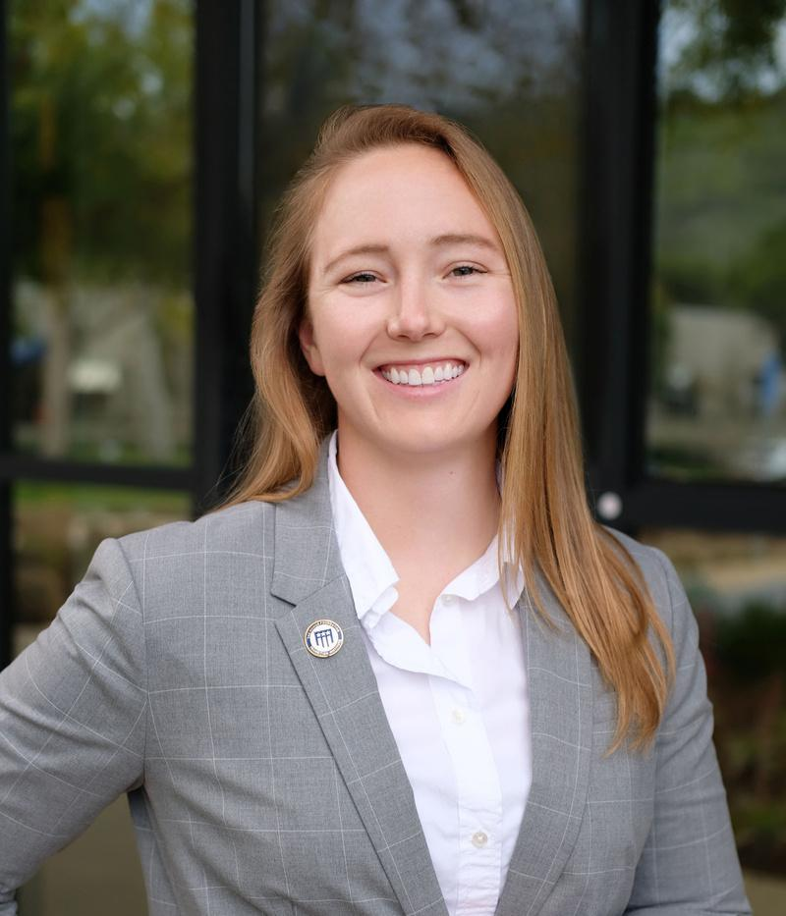
our team
Fahad Nabi
Elysia Smyers
Carmen Leiser
Lyndsea Warkenthien
Coterm Computer Science
Coterm Computer Science
Masters Design
Computer Science

Slide 3

broadening the definition...
active lifestyle

Slide 4

problem domain:
staying active when lifestyles change

Slide 5

needfinding methodology:
01
build rapport
02
seek stories
03
ask the right questions
04
follow up on interesting points

Slide 6
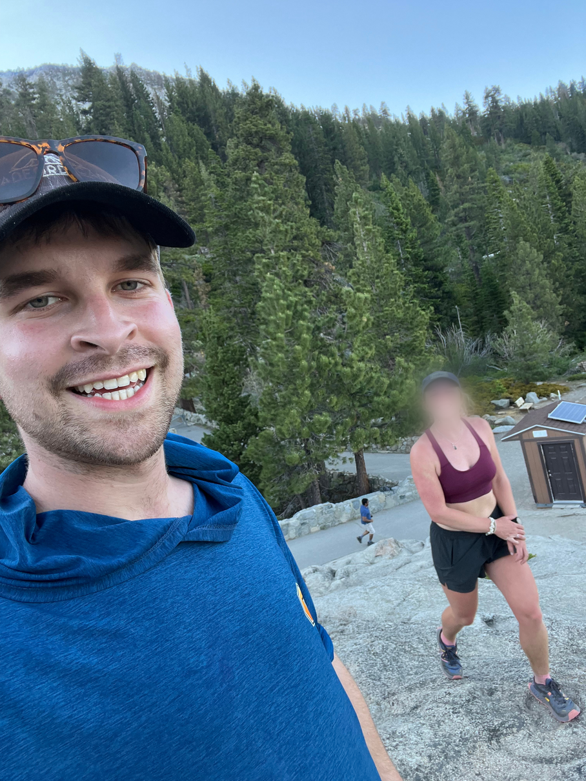
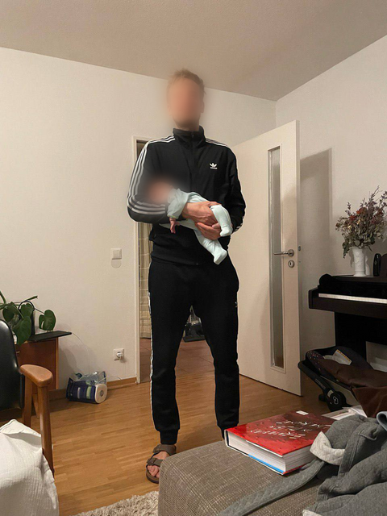
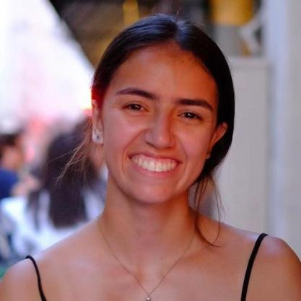
we talked to 3 people...
Nick
Ubai
Hannah
new environment
new parent
new chapter

Slide 7

everyone experiences change...
our participants want to stay active
Notes:
Needfinding methodology
a.Participants: Why were they chosen?
Why are they appropriate?
How were they recruited/compensated?
b.Where were the interviews conducted?
c.Who was your “extreme user”? In what axis are
they extreme?:
d.What did you ask?
e.Team member roles for each interview:
f. Apparatus–any equipment/software used (transcribing, etc.)

Slide 8

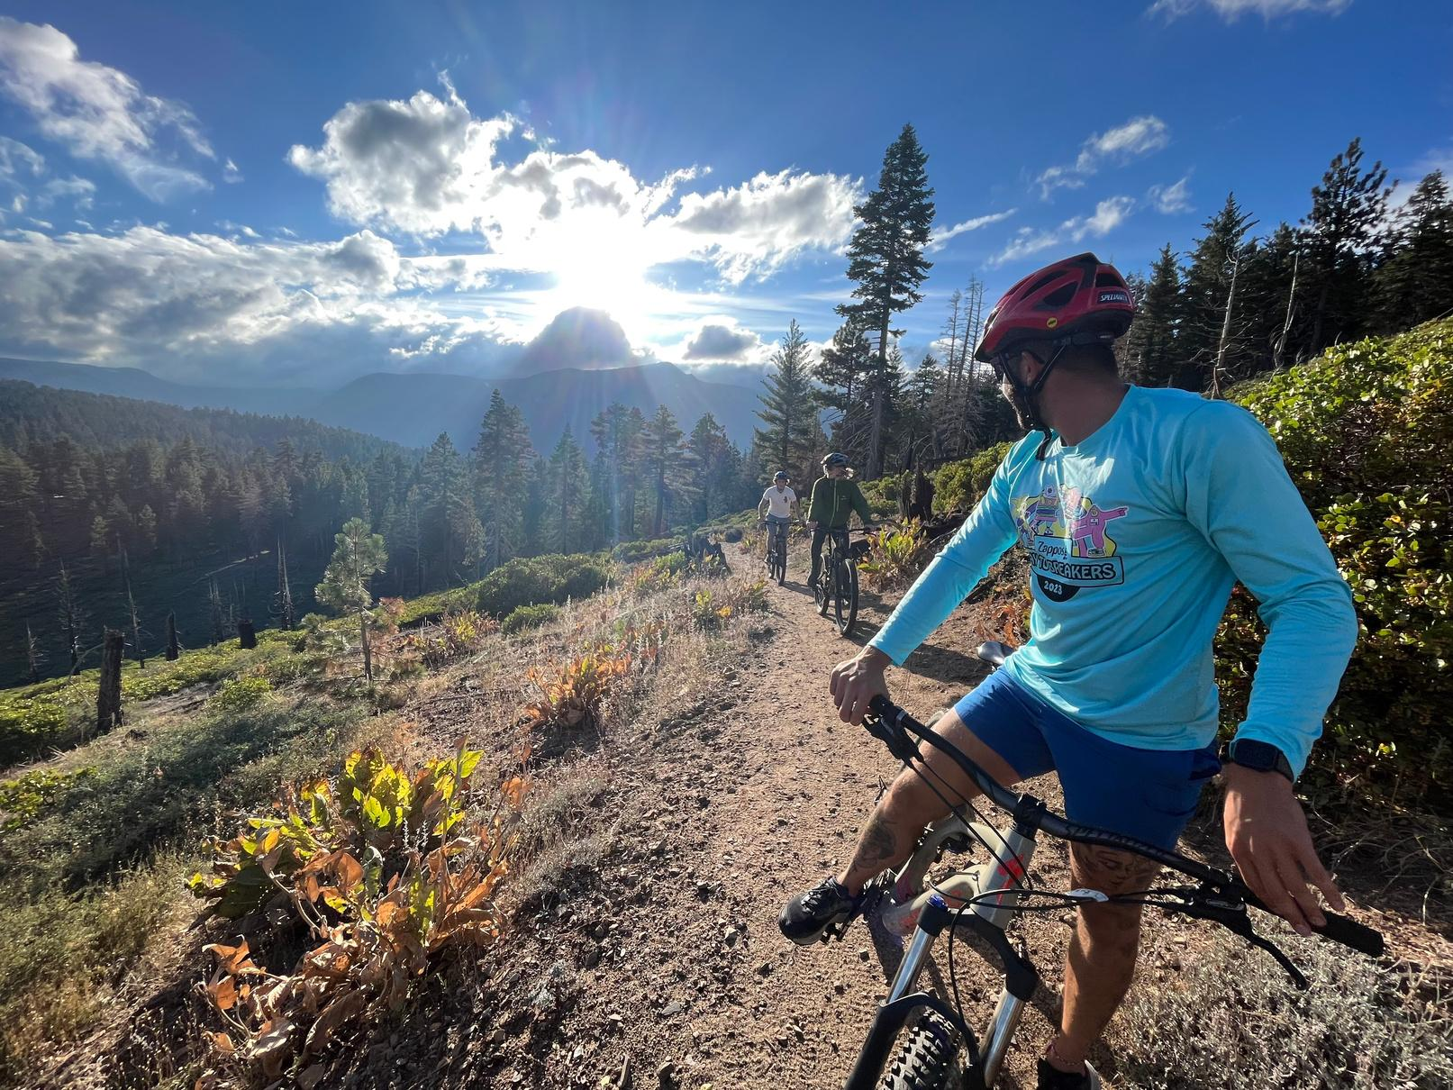

“I just log [physical activities] out of routine, and they’re more like nice things to look at. I find
functionally, they don’t encourage me to take further action, and lack the contextualization of
other aspects of my life, like changes in my environment.”
Nick

Slide 9
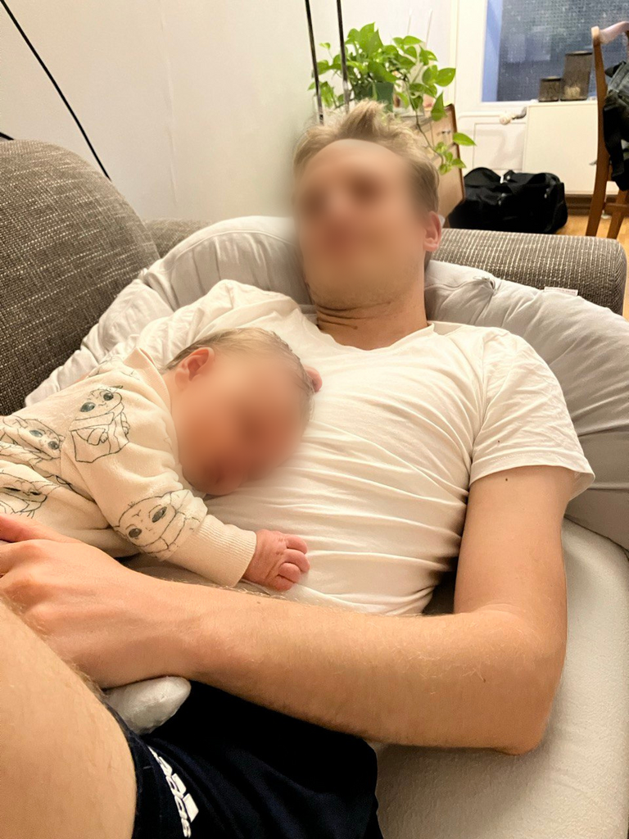
“I went from an active lifestyle to a more reactive lifestyle .”
Ubai

Slide 10
analysis:
surprises, tensions, & contradictions

Slide 11
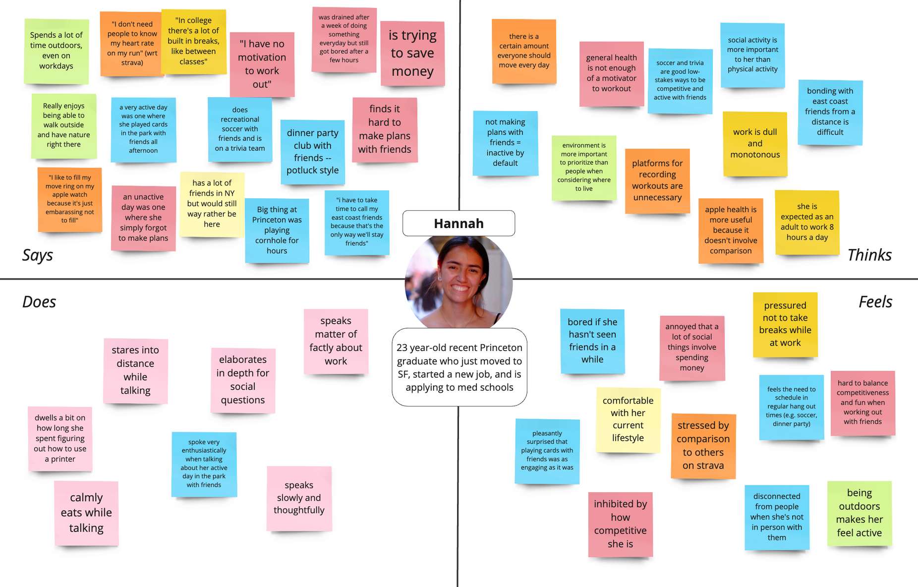

individual empathy map & analysis

Slide 12


“i have to take my time to call my east coast friends because that’s the only way we’ll stay friends”
“I have no motivation to work out”
SAY
“in college, there is a lot of built-in breaks between classes.”
“I don’t need people to know my heart rate on my run” (wrt to Strava)
spoke enthusiastically when talking bout her active day in the park with friends
DOES
speaks slowly and thoughtfully
elaborates in depth for social questions
speaks matter of factly about work

Slide 13
THINK
there is a certain about everyone should move every day
social activity is more important to her than physical activity
she is expected to be an adult and that means working 8 hrs a day
not making plans with friends = inactive
FEEL
hard to balance competitiveness with working out with friends
bored if she hasn’t seen friends in a while
annoyed that a lot of social things involve spending money
stressed by comparison to others on Strava

Slide 14

learnings from hannah
Insight
Needs
Younger people have less of a pressing motivation to stay physically active, so social activity often takes precedence.
Young adults need ways to stay physically active that also leverage the appeal of social activity.
Young adults need ways to connect with friends that do not involve spending money.

Slide 15
learnings from hannah
Insight
Needs
For some, platforms like Strava do more harm than good because people feel pressured to constantly compare themselves to others.
Young adults need a way to balance competitiveness and enjoyment in physical activities.

Slide 16
learnings from hannah
Insight
Needs
People often feel mentally drained by the idea that they are obligated to work all day in adult life.
People need a way to feel more mentally distanced from work when taking breaks during the work day.

Slide 17

summary key learnings:
need: gain autonomy of an active lifestyle during significant life transitions
insight: for strategies for physical activity to be sustainable they should be tailored to the individual
insight: maybe there is space for a tool that provides a blend of structured and unstructured physical activity
insight: transition requires specialized support and resources to adjust routines and responsibilities
need: ways to stay active with limited resources
insight: social influence plays a role in one's physical activity patterns

Slide 18


questions

Slide 19

appendix

Slide 20
Interviewee consent forms
Empathy maps
Interview plan
Organized interviews and methodology

